Slide 1
Instance Variable
public class ABC { public static void main(String[] args) { Test t=new Test(); t.marks=20; System.out.println(t.roll); System.out.println(t.marks); } } class Test{ int marks; int roll=10;}
Static variable
public class ABC { public static void main(String[] args) { Test t=new Test(); Test tt=new Test(); t.marks=20; tt.marks=900; System.out.println(tt.marks); System.out.println(t.marks); } } class Test{ static int marks; }
Local variable
public class ABC { public static void main(String[] args) { int k=100; System.out.println("the value is"+k); Test t=new Test(); t.display(); } } class Test{ void display(){ int pp=200; System.out.println(pp); }}
Instance method
public class ABC { public static void main(String[] args) { ABC a = new ABC(); System.out.println("void main"); a.display(); } void display(){ System.out.println("from instance "); } }

Slide 2
Instance with another class
public class ABC { public static void main(String[] args) { Hello h=new Hello(); h.display(20); } } class Hello{ void display( int aa){ int zz=aa*aa; System.out.println("from instance "+zz); } }
Static method
public class ABC { public static void main(String[] args) { ABC.display(); } static void display(){ int x=400; System.out.println(x); } }
Instance with return type
public class ABC { public static void main(String[] args) { Test t=new Test(); t.display(); } } class Test{ int add(){ int a=10;int b=20; return (a+b); } void display(){ int zz=add(); System.out.println(zz); } }
Static method in another class
public class ABC {
public static void main(String[] args) {
Test.display(); } }
class Test{
static void display(){
int x=4000;
System.out.println(x); } }

Slide 3
class Test{
static int add(){
int a=40;int b=30;
return (a+b); } }
class Test1{
void disp(){
int p=Test.add();
System.out.println(p); } }
class ABC{
public static void main(String[] args){
Test1 t=new Test1();
t.disp(); } }
class Test{
static int add(){
int a=40;int b=30;
return (a+b); }
void disp(){
int p=add();
System.out.println(p); } }
class ABC{
public static void main(String[] args){
Test t=new Test();
t.disp(); }}
public class Test{
int a=10;
static int y=30;
public static void main(String []args){
int p=50; System.out.println("local"+p+"static"+y); } }

Slide 4
Parameter constructor
package proj1;
class Test {
int a,b;
Test( int p, int y){
a=p;b=y;
System.out.println("A"+a+" "+b);
System.out.println("parameter costructor");
} }
class Run{
public static void main(String [] args) {
Test t=new Test(5,7); } }
Default constructor
package proj1;
class Test {
int a;
Test(){
int a=20;
System.out.println("A"+a);
System.out.println("Default costructor");
} }
class Run{
public static void main(String [] args) {
Test t=new Test(); }}

Slide 5
Single inheritance
public class SOE {
public static void main(String args[]) {
Son s=new Son();
s.getdata(10, 20);
s.display();}
}
class Father {
int a,b;
void getdata( int p, int y){
a=p;b=y;
System.out.println("A"+a+" "+b);
}}
class Son extends Father{
int add() {
int sum=a+b;
return sum;}
void display() {
System.out.println("a"+a);
System.out.println("a"+b);
System.out.println(add());
}}
Multilevel
public class SOE {
public static void main(String args[]) {
Grandson G=new Grandson();
G.display(); } }
class Father {
int a=20;}
class Son extends Father{
int b=30;}
class Grandson extends Son{
int c=80;
void display() {
System.out.println(a);
System.out.println(b);
System.out.println(c);
} }

Slide 6
Method overriding
public class Main {
public static void main(String args[]) {
Father f=new Father(); f.cal();
Son s=new Son(); s.cal();
Daughter d=new Daughter(); d.cal();
} }
class Father {
int a=20;
void cal() {
System.out.println(a); } }
class Son extends Father{
int b=30;
void cal() {
System.out.println(a+b); } }
class Daughter extends Father{
int c=80;
void cal() {
System.out.println(a+c); } }
Hierarchal
public class Main {
public static void main(String args[]) {
Son s=new Son(); s.disps();
Daughter d=new Daughter();
d.dispd();} }
class Father { int a=20; }
class Son extends Father{
int b=30;
void disps() {
System.out.println(a);
System.out.println(b); } }
class Daughter extends Father{
int c=80;
void dispd() {
System.out.println(a);
System.out.println(c); } }

Slide 7
Interface
public class Main {
public static void main(String []args) {
Son s=new Son();
s.add();}}
interface Father{
static final int k=100;
public void add(); }
class Son implements Father{
int c=10+Father.k;
public void add() {
System.out.println(c);} }
Abstract class
public class Main {
public static void main(String args[]) {
//Father f=new Father();f.cal();
Son s=new Son();
s.cal();
Daughter d=new Daughter();
d.cal(); } }
abstract class Father {
abstract void cal() ; }
class Son extends Father{
void cal() {
System.out.println("From sublcass"); }}
class Daughter extends Father{
void cal() {
System.out.println("From Daughter");}}
Multiple inheritance
public class Person implements i1,i2 {
public void show() {
System.out.println("Show"); }
public void display() {
System.out.println("Display");}
public static void main(String [] args) {
Person p=new Person();
p.show(); p.display(); }}
interface i1{ void show(); }
interface i2{ void display();}

Slide 8
Multiple interface implements
public class Main {
public static void main(String []args) {
Son s=new Son();
s.disp(); s.add();}}
interface Father{
static final int k=100;
public void add();}
interface Mother{
int mark=200;
public void disp();}
class Son implements Father, Mother{
int sum=Father.k+Mother.mark;
public void disp() {
System.out.println("inside son");}
public void add() {
System.out.println("Apple"+sum);}}
Interface extends and implements
public class Main {
public static void main(String []args) {
Son s=new Son();
s.disp();}}
class Father{
int k=100;
int add(int c) {return k+c;} }
interface Mother{
int mark=200;
public void disp(); }
class Son extends Father implements Mother{
int sum=k+Mother.mark;
public void disp() {
System.out.println("inside son");
System.out.println(add(5)); } }

Slide 9
Hybrid inheritance
public class Main {
public static void main(String []args) {
Result r=new Result();
r.display();
r.display();}}
class Student{
int roll=20;
int practical=50; }
class Exam extends Student{
int theory=100;
int total=theory+practical; }
interface Project{
int pmark=100;
void display(); }
class Result extends Exam implements Project{
int gtotal=practical+Project.pmark;
public void display() {
System.out.println( roll);
System.out.println( theory);
System.out.println(practical);
System.out.println(Project.pmark);
System.out.println(gtotal);}}
Unhide super class instance variable
public class Main {
public static void main(String []args) {
Son s=new Son();
s.display();}}
class Father{
int a=100; }
class Son extends Father{
int a=200;
void display() {
A=2000;
System.out.println(super.a);
System.out.println(a); }}

Slide 10
Try throw
public class Main {
public static void main(String []args) {
try {
int a=100; int b=10;
int c=a/b;
System.out.println(c);}
catch(Exception e) {
System.out.println(e);
e.printStackTrace(); }
System.out.println("Hello");}}
package puja;
import java.io.*;
import java.io.PrintWriter;
import java.io.FileWriter;
import java.util.Vector;
public class Main {
public void writeNum() {
try {
PrintWriter o=new PrintWriter(new FileWriter("hh.txt"));
for(int i=1;i<10;i++)
o.println(i);
o.close();
}catch(IOException e) {
System.out.println("IOError");}}
public static void main(String []args) {
SOE s=new SOE();
s.writeNum();}}
import java.util.Scanner;
class Main {
public static void main(String []args) {
try { Scanner s=new Scanner(System.in);
System.out.println("Enter Integer");
int a=s.nextInt();
System.out.println("Enter Second");
int b=s.nextInt(); int c=a/b;
System.out.println(a); System.out.println(b);
System.out.println(c); }
catch(ArithmeticException ee) {
System.out.println("Divide errors");}}}

Slide 11
public class Main{
public static void main(String[] args) {
try {
int arr[]= {1,3,5,7};
System.out.println(arr[10]);
//may throw exception
} // handling the array exception
catch(ArrayIndexOutOfBoundsException e) {
System.out.println(e); }
System.out.println("rest of the code"); } }
Multiple catches
class Main {
public static void main(String []args) {
try {
int k=100/3;
System.out.println("A"+k);
int arr[]=new int [5];
arr[5]=90;
System.out.println("Array"+arr[5]);
String s="Nepal";
System.out.println(s.length()); }
catch(ArithmeticException ee) {
System.out.println("Divide errors Exception");}
catch(ArrayIndexOutOfBoundsException ee) {
System.out.println("Array index Exception");}
catch(NullPointerException ee) {
System.out.println("Dont null pointerException");}}

Slide 12
Reflection API
import java.lang.reflect.Field;
class SOE {
public static void main(String []args) {
Sita s=new Sita("Bijaya");
try {
Field fs= s.getClass().getDeclaredField("name");
fs.setAccessible(true);
System.out.println(fs.get(s));}
catch(Exception ee) {
ee.printStackTrace();}
} }
public class Sita {
private String name;
Sita(String kk){
this.name=kk;
System.out.println(name);}
public static void main(String[] args) {
Sita ss=new Sita("Bina");}}
package com.test;
public class Person {
private int a=10;
private static int k;
Person(){
System.out.println("Hello");}
Person(int k, int y){
this.a=k; Person.k=y;
System.out.println(a+"Parameter constructor"+k);}
void add() {System.out.println("From add"+a);}
void apple() {System.out.println("From apple"+k);}
public static void main(String[] args) {
Person p=new Person();
Person pp=new Person(20,30);
p.add(); pp.apple();}}

Slide 13
package com.test;
import java.lang.reflect.Field;
import java.lang.reflect.Constructor;
import java.lang.reflect.Method;
public class Main {
public static void main(String[] args) {
try {
Class c=Class.forName("com.test.Person");
System.out.println("Name is: "+c.getName());
System.out.println("----------");
System.out.println("Name is: "+c.getSuperclass().getName());
System.out.println("----------");
Person person=(Person)c.newInstance();
person.add(); person.apple();
System.out.println("----------");
Field [] f=c.getDeclaredFields();
for(Field field:f) {System.out.println(field);}
System.out.println("----------");
Constructor cons[]=c.getDeclaredConstructors();
for(Constructor cc:cons) {System.out.println(cc);}
System.out.println("----------");
Method m[]=c.getDeclaredMethods();
for(Method mm:m) {System.out.println(mm);} }
catch(Exception e) {e.printStackTrace();} }}
Reflection to Main class
package com.test;
public class Person {
private int a=10;
private static int k;
Person(){
System.out.println("Hello");}
Person(int k, int y, int cc){
this.a=k;
Person.k=y;
System.out.println(a+"Parameter constructor"+k);}
void add() {
System.out.println("From add"+a);}
void apple() {
System.out.println("From apple"+k);}
public static void main(String[] args) {
Person p=new Person();
Person pp=new Person(20,30,40);
p.add();
pp.apple(); } }

Slide 14
File
import java.io.File;
import java.io.*;
public class Person {
public static void main(String[] args) throws IOException {
File f1=new File("D:/java/name.txt");
f1.createNewFile();
System.out.println("can read: "+f1.canRead());
System.out.println("can write: "+f1.canWrite());
System.out.println("can exist: "+f1.exists());
System.out.println("can name: "+f1.getName());
System.out.println("can length: "+f1.length()); }}
import java.io.*;
public class Person {
public static void main(String[] args) throws IOException {
int i;
FileOutputStream fout=new FileOutputStream("D:/java/name3.txt",true);
String s="ONETWO THREE";
char ch[]=s.toCharArray();
for(i=0;i<s.length();i++)
fout.write(ch[i]);
fout.close(); }}

Slide 15
import java.io.*;
public class Person {
public static void main(String[] args) throws IOException {
int i;
FileInputStream fn=new FileInputStream("D:/java/name.txt");
do {
i=fn.read();
if(i!=-1)
System.out.print((char)i);}
while(i!=-1);
fn.close();}}
import java.io.*;
public class Person {
public static void main(String[] args) throws IOException {
FileWriter fw=new FileWriter("D:/java/name4.txt",true);
BufferedWriter bf=new BufferedWriter(fw);
bf.write("Computer and software");
bf.close();}}
import java.io.*;
public class Person {
public static void main(String[] args) throws IOException {
BufferedReader bf=new BufferedReader(new FileReader("D:/java/name4.txt"));
String s1;
while((s1=bf.readLine())!=null)
System.out.println(s1);
bf.close(); }}

Slide 16
import java.util.ArrayList;
public class Person {
public static void main(String [] args) {
ArrayList<Integer>li=new ArrayList<Integer>(5);
li.add(1); li.add(3); li.add(10);
for(Integer x: li)
System.out.println(x);
} }
Method overriding
class parent1{
void show() {
System.out.println("1");} }
class xyz extends parent1{
void show() {
System.out.println("2");}}
public class Person {
public static void main(String[] args) {
xyz x=new xyz();
x.show(); }}
Public private
class parent1{
private int i=10;
void m1() {
System.out.println(i);}}
class child1 extends parent1{
void s() {
System.out.println(i); } }
public class Person {
public static void main(String[] args) {
child1 c=new child1();
c.s();
c.m1();}}

Slide 17
Static block
public class Person {
static {System.out.println("Hello");}
public static void main(String[] args) { }
static {System.out.println("Hello2");} }
String
public class Ap {
public static void main(String[] args) {
String s=" my string";
System.out.println(s.length());
if(s.isEmpty())
System.out.println(s.trim());
else
System.out.println("value"); }}
if(s.trim().length()==0)
abstract class Vehicle{
abstract void show();}
class car extends Vehicle{
void show() {
System.out.println("car has four wheels");} }
class scotter extends Vehicle{
void show() {
System.out.println("Scoter has two wheels");} }
public class Person {
public static void main(String[] args) {
scotter s=new scotter();
s.show();
car c=new car();
c.show();} }

Slide 18
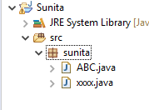
package sunita;
public class ABC {
int a=30;
private int b=10;
protected int c=40;
public int d=90;
public void show() {
System.out.println(a+b+c+d);
} }
package sunita;
public class xxxx {
public static void main(String[] args) {
ABC p=new ABC();
p.show();} }

Slide 19
Applet in Java programming
An applet is a Java program that runs in a Web browser. An applet can be a fully functional Java application because it has the entire Java API at its disposal.
There are some important differences between an applet and a standalone Java application, including the following −
An applet is a Java class that extends the java.applet.Applet class.
A main() method is not invoked on an applet, and an applet class will not define main().
Applets are designed to be embedded within an HTML page.
When a user views an HTML page that contains an applet, the code for the applet is downloaded to the user's machine.
A JVM is required to view an applet. The JVM can be either a plug-in of the Web browser or a separate runtime environment.
The JVM on the user's machine creates an instance of the applet class and invokes various methods during the applet's lifetime.
Applets have strict security rules that are enforced by the Web browser. The security of an applet is often referred to as sandbox security, comparing the applet to a child playing in a sandbox with various rules that must be followed.
Other classes that the applet needs can be downloaded in a single Java Archive (JAR) file.

Slide 20
import java.applet.Applet;
import java.awt.Graphics;
import java.awt.Color;
public class Applet11 extends Applet{
public void paint(Graphics g) {
g.drawString("Hello students yagya rimal", 100, 100);
g.setColor(Color.YELLLOW);
g.drawString("My name is",400,300);
g.setColor(Color.RED);
g.drawRect(300,150,200,100);
g.setColor(Color.YELLOW);
g.fillRect( 300,150, 200, 100 );
g.setColor(Color.MAGENTA);
g.drawString("Rectangle",500,150); } }
//<html><title></title><body>
<APPLET code="Applet11.class",width="200" height="300">
</APPLET>
//</body></HTML> first run on .html
//C:\jdk1.2.2\applet>appletviewer Applet11.java
//C:\jdk1.2.2\applet>javac Applet11.java
//C:\jdk1.2.2\applet>appletviewer Applet11.java

Slide 21
Life Cycle of an Applet
Four methods in the Applet class gives you the framework on which you build any serious applet −
init − This method is intended for whatever initialization is needed for your applet. It is called after the param tags inside the applet tag have been processed.
start − This method is automatically called after the browser calls the init method. It is also called whenever the user returns to the page containing the applet after having gone off to other pages.
stop − This method is automatically called when the user moves off the page on which the applet sits. It can, therefore, be called repeatedly in the same applet.
destroy − This method is only called when the browser shuts down normally. Because applets are meant to live on an HTML page, you should not normally leave resources behind after a user leaves the page that contains the applet.
paint − Invoked immediately after the start() method, and also any time the applet needs to repaint itself in the browser. The paint() method is actually inherited from the java.awt.

Slide 22
import java.applet.Applet;
import java.awt.Graphics;
import java.awt.Color;
public class Applet11 extends Applet{
int count=1;
public void init(){System.out.println("Init"+count++);}
public void start(){System.out.println("Start“ +count++);}
public void stop(){System.out.println("stop"+count++);}
public void paint(Graphics g){
System.out.println("paint"); g.drawString("Hello Student",30,40);}
public void destory(){ System.out.println("Destory"+count++);} }
//<html><title></title><body><APPLET code="Applet11.class",width="200" height="300"></APPLET>
//</body></HTML> first run on .html
//C:\jdk1.2.2\applet>javac Applet11.java
//C:\jdk1.2.2\applet>appletviewer Applet11.java
//C:\jdk1.2.2\applet>appletviewer a.html

Slide 23
import java.applet.*;
import java.awt.*;
public class Myapp extends Applet{
public void paint(Graphics g) {
String str=this.getParameter("msg");
g.drawString(str,100,80); } }
//<html><title></title><body>
//<APPLET code="Myapp.class",width="600" height="600">
//<PARAM name="msg" value="Visit Nepal"></APPLET>
//</body></HTML>

Slide 24
import java.applet.*;
import java.awt.*;
public class Myapp extends Applet{
Font obj=new Font("Times New Roman",Font.BOLD,40);
public void paint(Graphics g) {
String str=this.getParameter("msg");
g.setFont(obj);
g.drawString(str,100,80); } }
//<html><title></title><body>
//<APPLET code="Myapp.class",width="600" height="600">
//<PARAM name="msg" value="Visit Nepal 2020"></APPLET>
//</body></HTML>

Slide 25
import java.applet.*;
import java.awt.*;
public class My extends Applet{
Font obj=new Font("Times New Roman",Font.BOLD,40);
Font obj1=new Font("sarif",Font.ITALIC,20);
public void paint(Graphics g) {
g.setFont(obj); g.drawString("apple",10,80);
g.setFont(obj1); g.setColor(Color.RED);
g.drawString("Banana",100,80);
g.drawRect(200,200,100,100); } }
//<html><title></title><body>
//<APPLET code="My.class",width="600" height="600">
//<PARAM name="msg" value="Visit Nepal"></APPLET> //</body></HTML>

Slide 26
import java.applet.*;
import java.awt.*;
import java.awt.event.*;
public class Mi extends Applet implements ActionListener{
String name=" ", gender=" "; int age;
TextField n=new TextField(10);
CheckboxGroup g=new CheckboxGroup(); Checkbox m=new Checkbox("Male",g,true);
Checkbox f=new Checkbox("Female",g,false); Choice c=new Choice();
Label l1=new Label("Enter Name:"); Label l2=new Label("Select Gender");
Label l3=new Label("Age"); Button b1=new Button("Submit");
public void init(){
add(l1); add(n); add(l2); add(m); add(f); add(l3);
c.add("18"); c.add("19"); c.add("20"); c.add("21"); add(c); add(b1); b1.addActionListener(this); }
public void paint(Graphics g){
g.drawString("Name:"+name,20,100); g.drawString("Gender:"+gender,20,120);
g.drawString("Age:"+age,20,150);}
public void actionPerformed(ActionEvent e){
name=n.getText();
gender=g.getSelectedCheckbox().getLabel(); age=Integer.parseInt(c.getSelectedItem()); repaint();}}
<html><title></title><body>
<APPLET code="Mi.class",width="600" height="600"> <PARAM name="msg" value="Visit Nepal"></APPLET> </body></HTML>

Slide 27
import java.awt.*;
import java.awt.event.*;
import java.awt.event.ActionListener;
import java.applet.Applet;
public class Example extends Applet{
Label l1,l2,l3; TextField t1,t2; Button b1;
public void init(){
l1=new Label("First Number"); l2=new Label("Second Number");
l3=new Label("");
t1=new TextField(); t2=new TextField();
b1=new Button("ADD"); setLayout(null);
l1.setBounds(30,50,100,20);
l2.setBounds(30,100,100,20);
t1.setBounds(150,50,100,20);
t2.setBounds(150,100,100,20);
b1.setBounds(100,150,100,20);
l3.setBounds(30,180,100,20);
add(l1); add(l2); add(t1); add(l3); add(t2); add(b1);
b1.addActionListener(new Handler()); }
class Handler extends Applet implements ActionListener{
public void actionPerformed(ActionEvent e){
int a=Integer.parseString(t1.getText()); int b=Integer.parseString(t2.getText());
int k=a-b; l3.setText("Result is" +k); }} }
C:\Users\user\Desktop\swing>javac Example.java
C:\Users\user\Desktop\swing>appletviewer a.html

Slide 28
import java.applet.*;
import java.awt.*;
import java.awt.event.*;
public class Play extends Applet implements ActionListener {
Button play,stop; AudioClip audioClip;
public void init() { play = new Button(" Play in Loop ");
add(play); play.addActionListener(this);
stop = new Button(" Stop "); add(stop);
stop.addActionListener(this);
audioClip = getAudioClip(getCodeBase(), "Sound.wav");}
public void actionPerformed(ActionEvent ae) {
Button source = (Button)ae.getSource();
if (source.getLabel() == " Play in Loop ") { audioClip.play();}
else if(source.getLabel() == " Stop "){ audioClip.stop(); } }}
//<html> <title>The ImageDemo applet</title> <hr>
<applet code = "Play.class" width = "100" height = "100"> <param name = "audio" value = "phool.wav"> </applet> <hr></html>

Slide 29
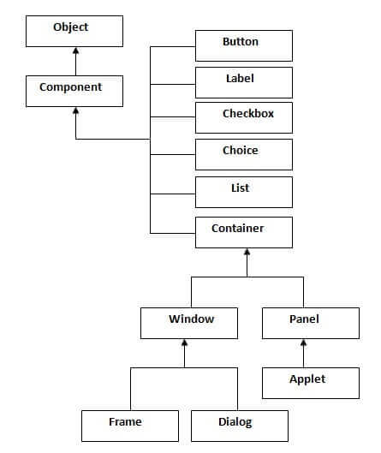
Java AWT
Java AWT (Abstract Window Toolkit) is an API to develop GUI or window-based applications in java.
Java AWT components are platform-dependent i.e. components are displayed according to the view of operating system. AWT is heavyweight i.e. its components are using the resources of OS.
The java.awt package provides classes for AWT api such as TextField, Label, TextArea, RadioButton, CheckBox, Choice, List etc.
Java AWT Hierarchy
The hierarchy of Java AWT classes are given below.

Slide 30
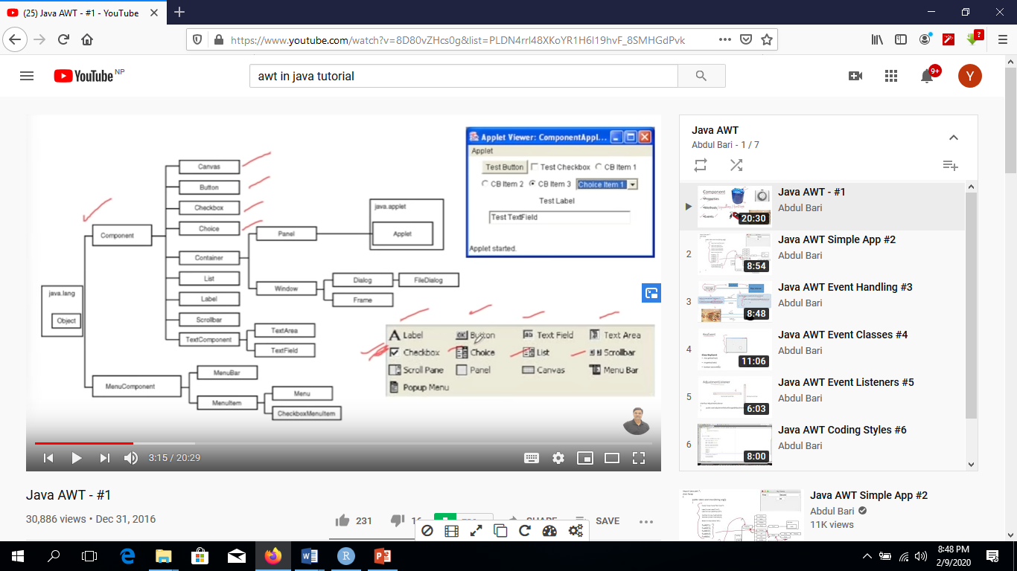

Slide 31
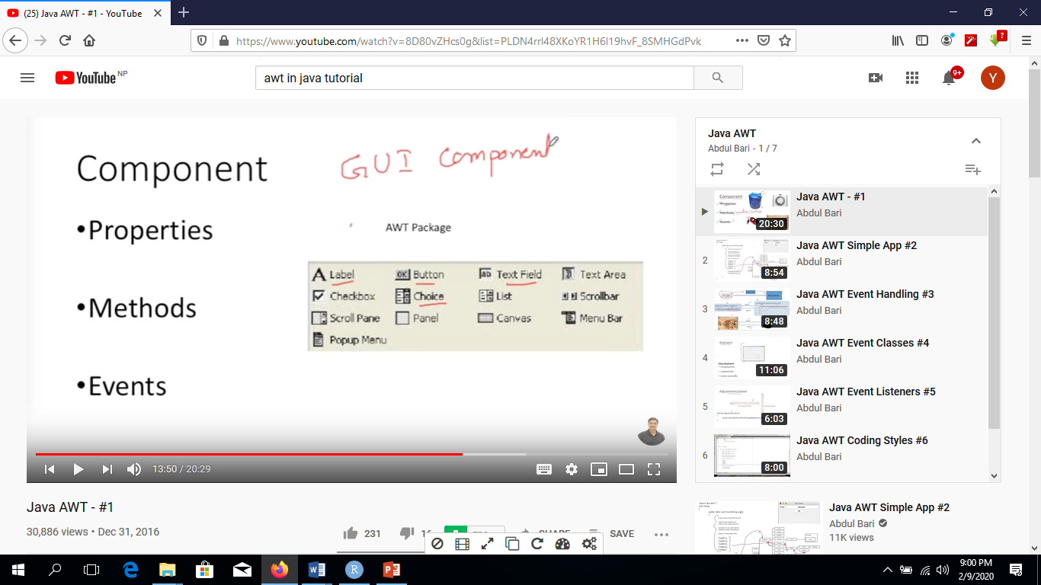

Slide 32
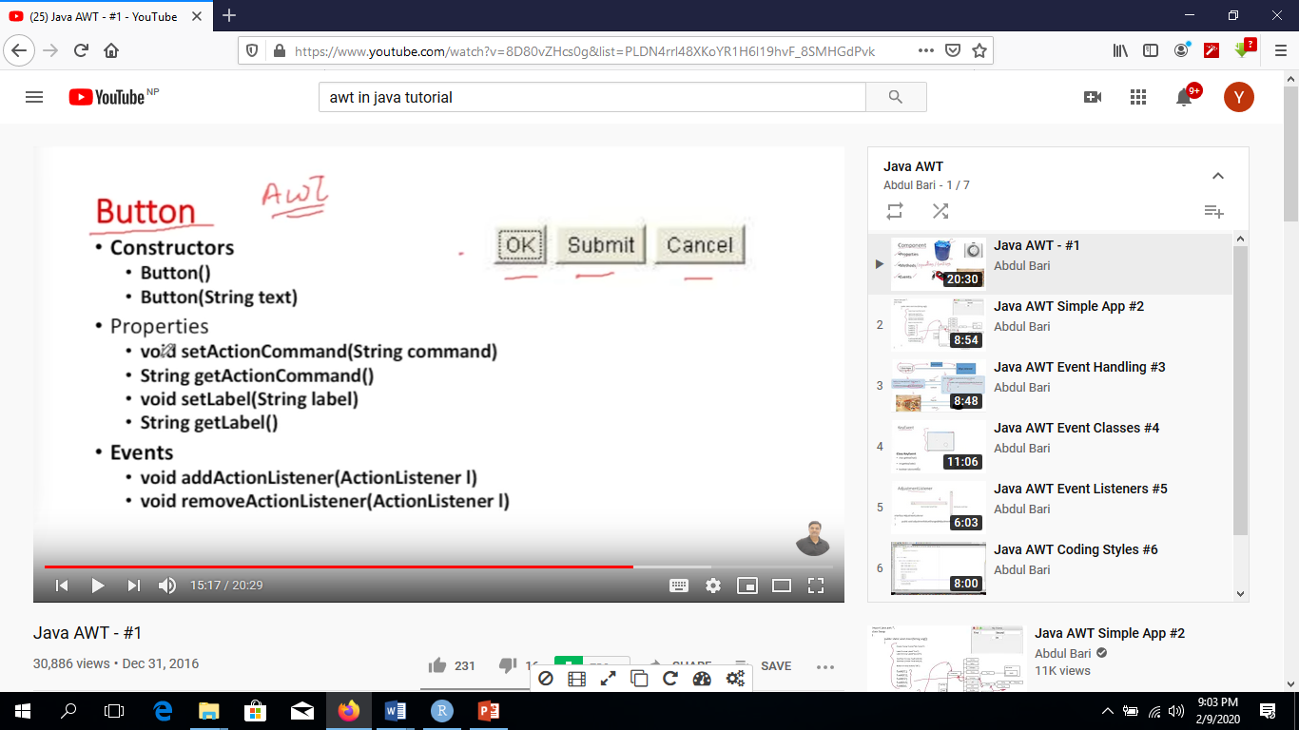
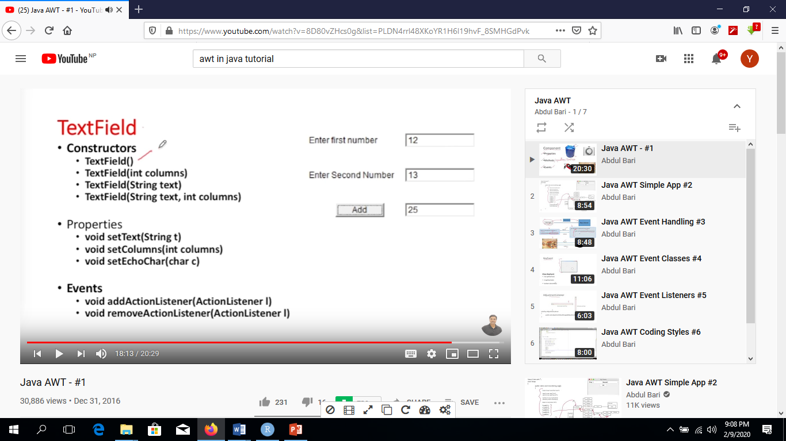

Slide 33
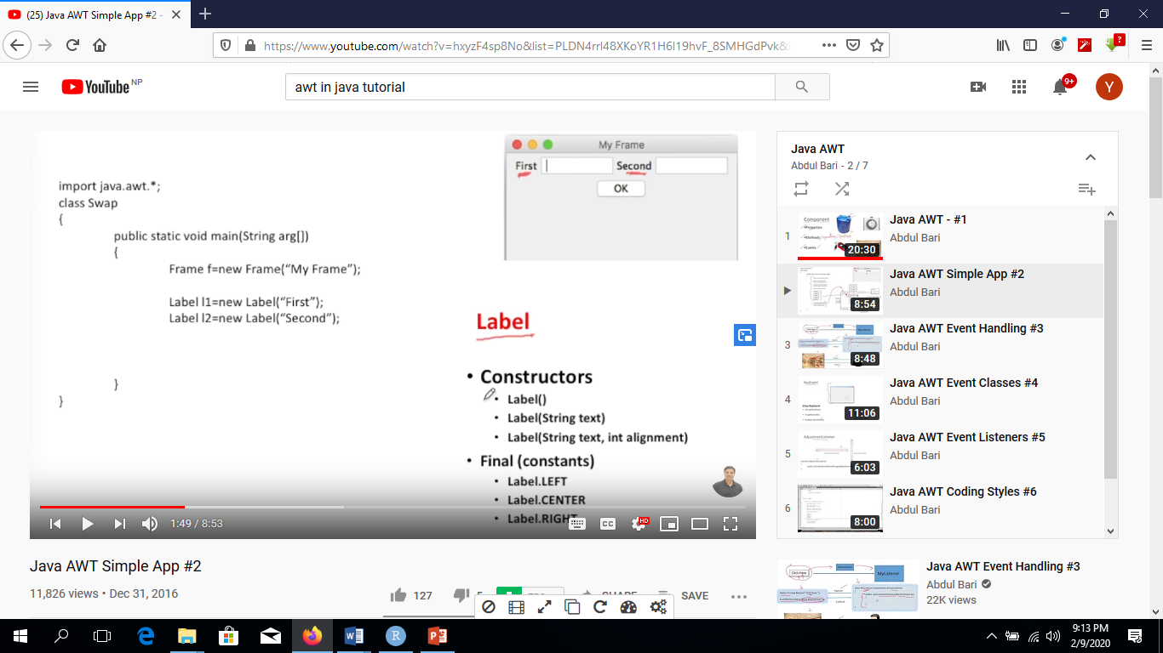
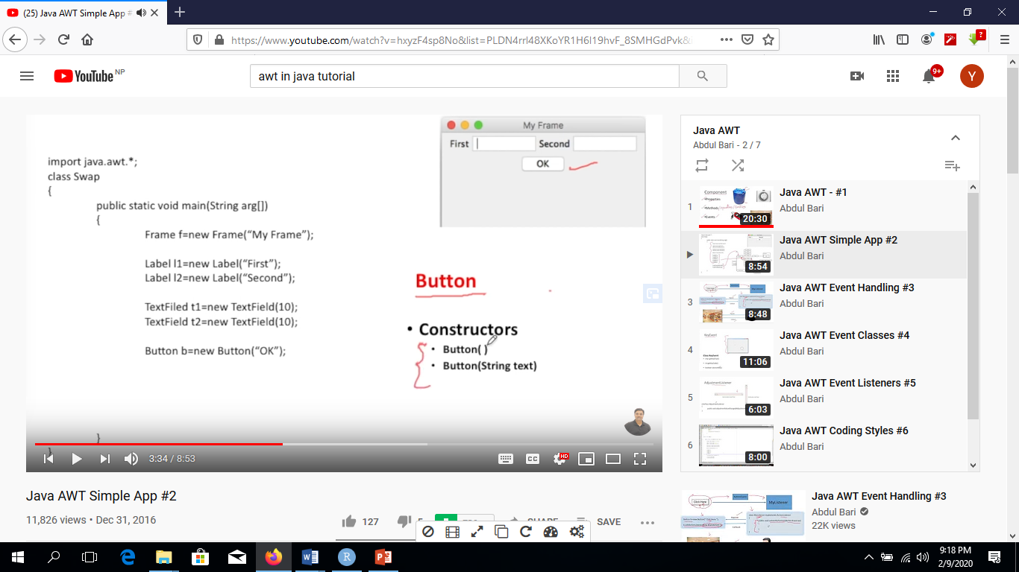
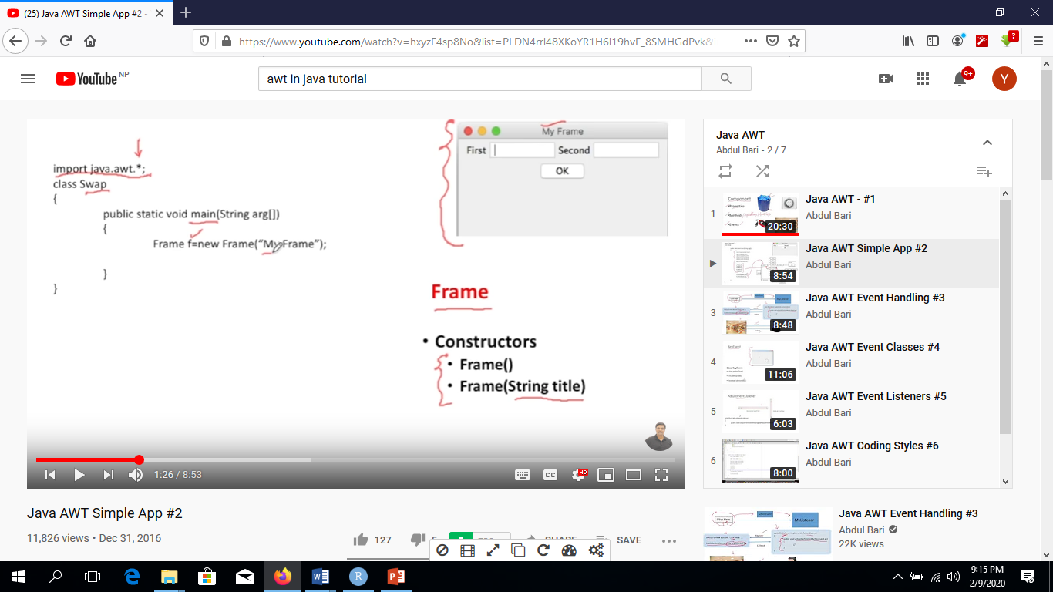
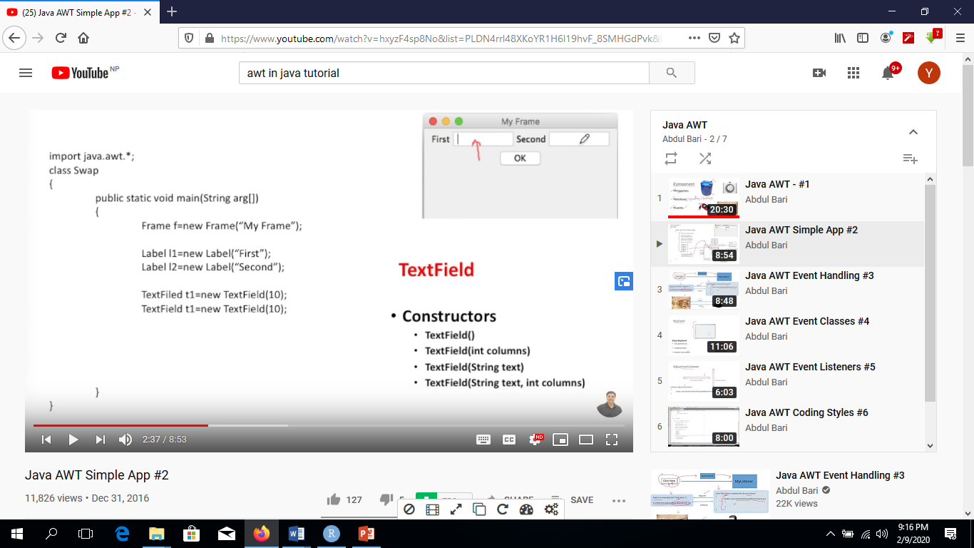
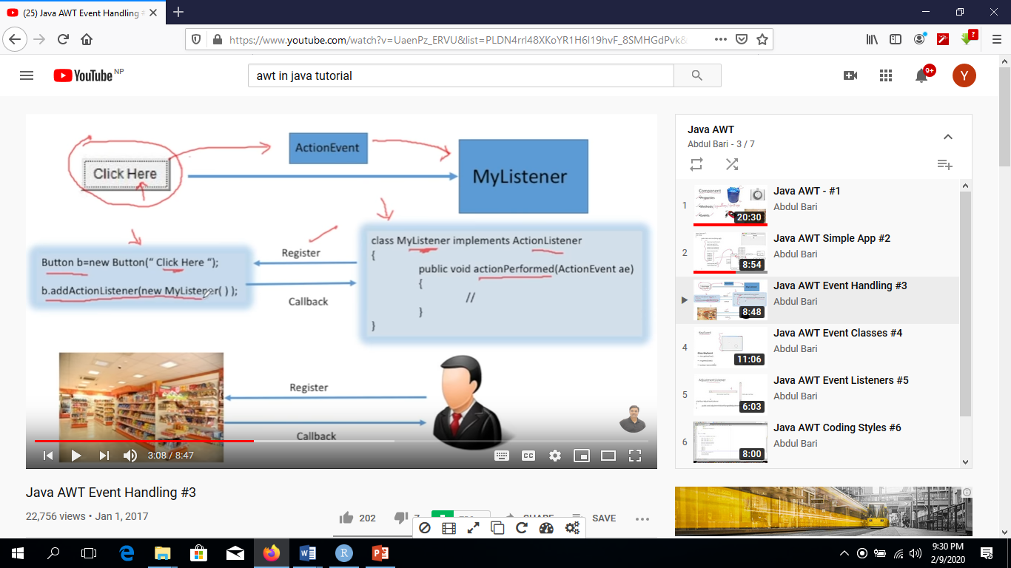

Slide 34
Method | Description
public void add(Component c) | inserts a component on this component.
public void setSize(int width,int height) | sets the size (width and height) of the component.
public void setLayout(LayoutManager m) | defines the layout manager for the component.
public void setVisible(boolean status) | changes the visibility of the component, by default false.

Slide 35
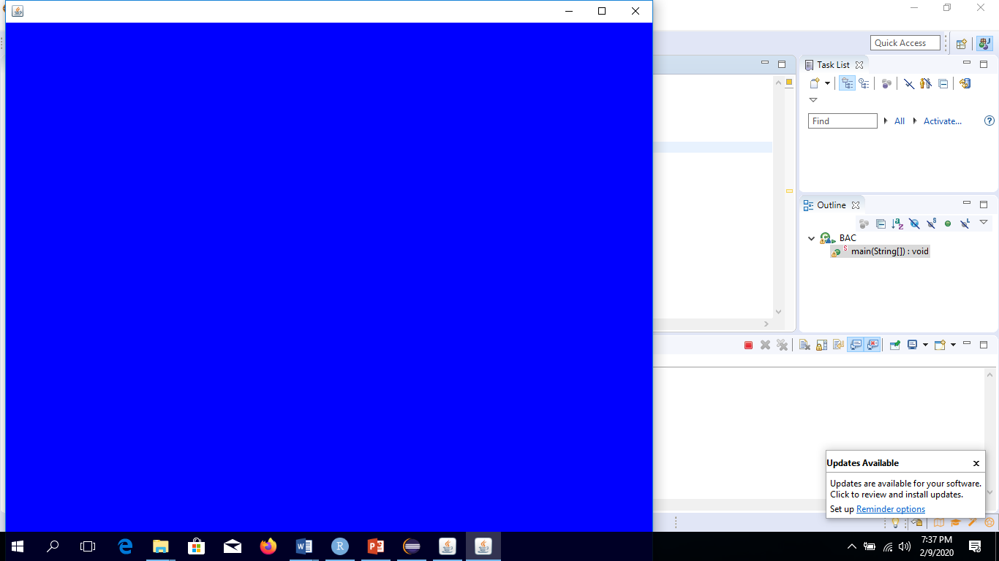
import java.awt.Frame;
import java.awt.Color;
class B {
public static void main(String [] args){
System.out.println("1");
Frame f=new Frame();
f.setVisible(true);
f.setSize(600,500);
f.setBackground(Color.BLUE);
f.resize(900,800);
boolean b=f.isVisible();
System.out.println(b);}}
import java.awt.event.*;
import java.awt.Frame;
class BAC extends Frame{
public static void main(String [] args){
BAC b=new BAC();
b.setTitle("New Title");
b.setSize(500,300);
b.setVisible(true);
System.out.println(b);
b.setLocation(100,50);
b.setBounds(100,200,900,300);
b.addWindowListener(new WindowAdapter() {
public void windowClosing(WindowEvent e) {
System.exit(0);}});
} }
Java AWT Example
To create simple awt example, you need a frame. There are two ways to create a frame in AWT.
By extending Frame class (inheritance)
By creating the object of Frame class (association)
public void setBounds(int xaxis, int yaxis, int width, int height); have been used in the above example that sets the position of the component it may be button, textfield etc.

Slide 36
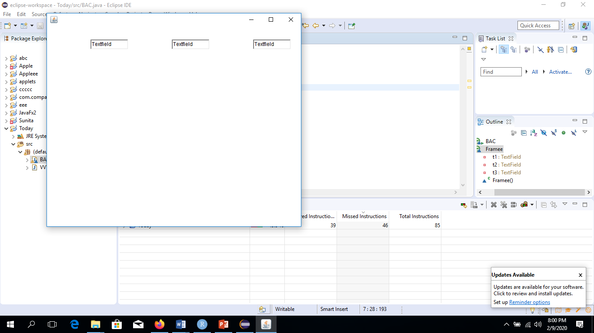
FlowLayout: The FlowLayout is used to arrange the components in a line, one after another
import java.awt.Frame;
import java.awt.TextField;
import java.awt.FlowLayout;
class E {
public static void main(String [] args){
Framee f=new Framee(); }}
class Framee extends Frame{
private TextField t1=new TextField("Textfield");
private TextField t2=new TextField("Textfield");
private TextField t3=new TextField("Textfield");
Framee(){
setVisible(true);
this.setSize(600,500); setLocation(100,30);
//FlowLayout la=new FlowLayout(FlowLayout.LEFT);
FlowLayout la=new FlowLayout(FlowLayout.LEFT,100,30);
setLayout(la);
add(t1); add(t2);add(t3); }}

Slide 37
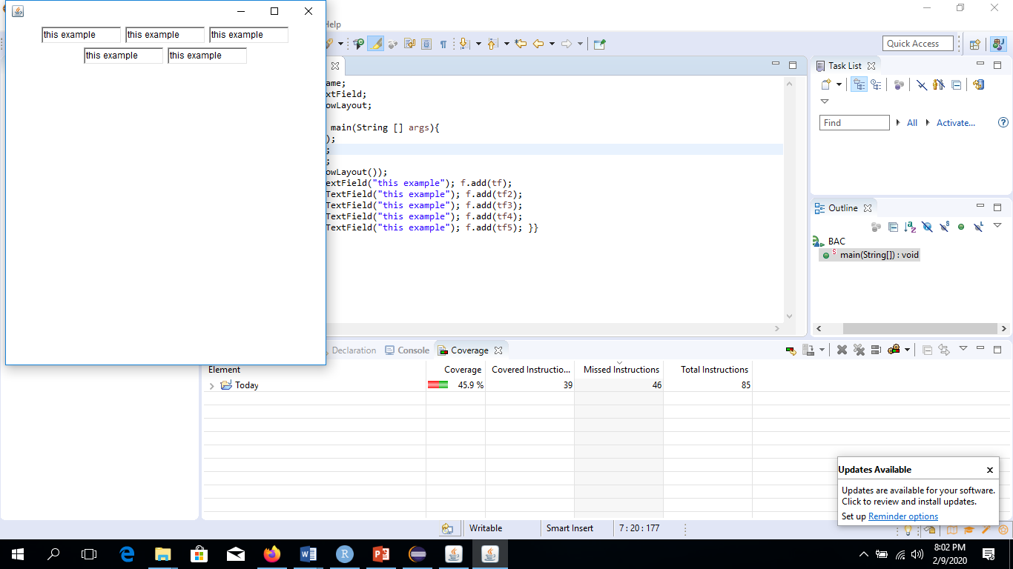
import java.awt.Frame;
import java.awt.TextField;
import java.awt.FlowLayout;
class I extends Frame{
public static void main(String[] args){
new I();}
public I(){
setVisible(true);
setSize(600,300);
setLayout(new FlowLayout());
TextField tf=new TextField("java");
add(tf);
//tf.setEditable(false);
//System.out.println(tf.isEditable());
tf.setText("Oracle");
tf.setText("VB");
System.out.println("the text is:"+tf.getText());
}}
TextField
isEditable()
setEditable(Boolean b)
setText(String s)
getText()
import java.awt.Frame;
import java.awt.TextField;
import java.awt.FlowLayout;
class E {
public static void main(String [] args){
Frame f=new Frame();
f.setVisible(true);
f.setSize(600,500);
f.setLayout(new FlowLayout());
TextField tf=new TextField("this example"); f.add(tf);
TextField tf2=new TextField("this example"); f.add(tf2);
TextField tf3=new TextField("this example"); f.add(tf3);
TextField tf4=new TextField("this example"); f.add(tf4);
TextField tf5=new TextField("this example"); f.add(tf5); }}
The object of a TextField class is a text component that allows the editing of a single line text

Slide 38
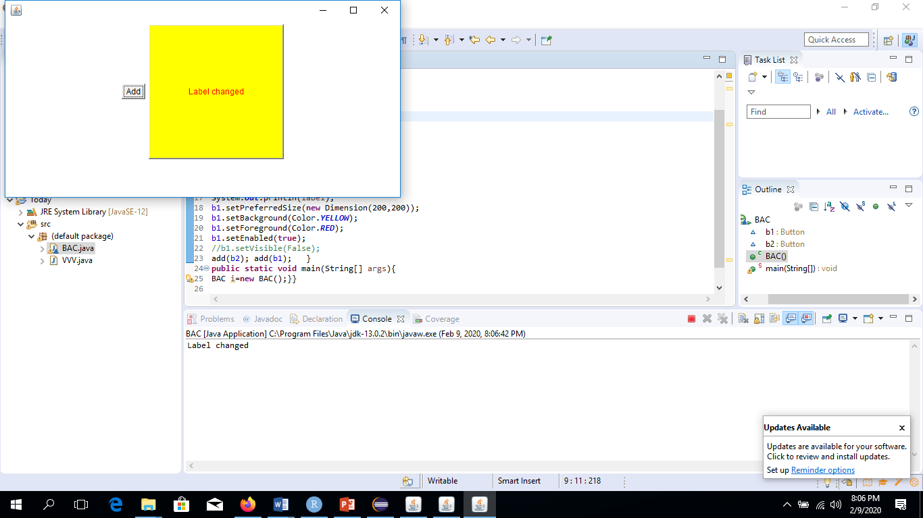
Button awt.Button Button() Button(String s)
import java.awt.Frame;
import java.awt.TextField;
import java.awt.Button;
import java.awt.FlowLayout;
import java.awt.Dimension;
import java.awt.Color;
class I extends Frame{
Button b1; Button b2;
public I(){
setVisible(true); setSize(600,300);
setLayout(new FlowLayout());
b1=new Button(); b2=new Button("Add");
b1.setLabel("Label added");
b1.setLabel("Label changed");
String label=b1.getLabel();
System.out.println(label);
b1.setPreferredSize(new Dimension(200,200));
b1.setBackground(Color.YELLOW);
b1.setForeground(Color.RED);
b1.setEnabled(true);
//b1.setVisible(False);
add(b2); add(b1); }
public static void main(String[] args){
I i=new I();}}
The button class is used to create a labeled button that has platform independent implementation. The application result in some action when the button is pushed.

Slide 39
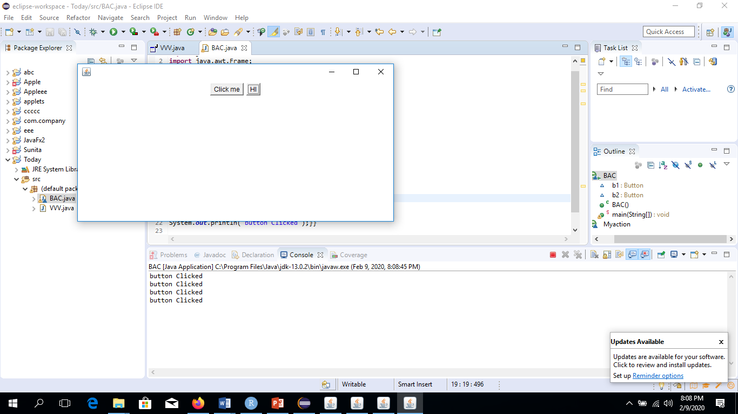
Event and Listener (Java Event Handling)
Java Event classes and Listener interfaces
import java.awt.Button;
import java.awt.Frame;
import java.awt.FlowLayout;
import java.awt.Dimension;
import java.awt.Color;
import java.awt.event.*;
class I extends Frame{
Button b1; Button b2;
public I(){
setSize(600,300);
setVisible(true);
setLayout(new FlowLayout());
b1=new Button("Click me");
b2=new Button("HI");
b1.addActionListener(new Myaction());
b2.addActionListener(new Myaction());
add(b1);add(b2); }
public static void main(String[] args){
I i=new I();}}
class Myaction implements ActionListener{
public void actionPerformed(ActionEvent e){
System.out.println("button Clicked");}}
Changing the state of an object is known as an event. For example, click on button, dragging mouse etc. The java.awt.event package provides many event classes and Listener interfaces for event handling.
Event Classes | Listener Interfaces
ActionEvent | ActionListener
MouseEvent | MouseListener and MouseMotionListener
MouseWheelEvent | MouseWheelListener
KeyEvent | KeyListener
ItemEvent | ItemListener
TextEvent | TextListener
AdjustmentEvent | AdjustmentListener
WindowEvent | WindowListener
ComponentEvent | ComponentListener
ContainerEvent | ContainerListener
FocusEvent | FocusListener

Slide 40
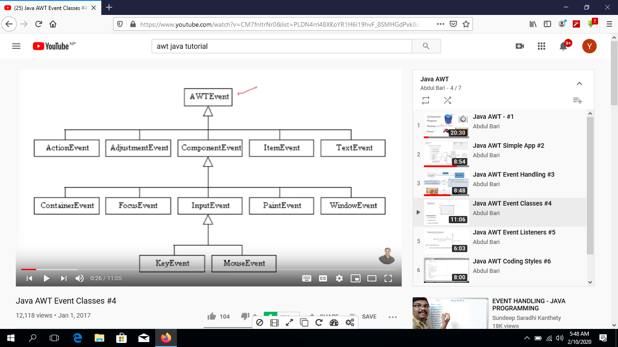
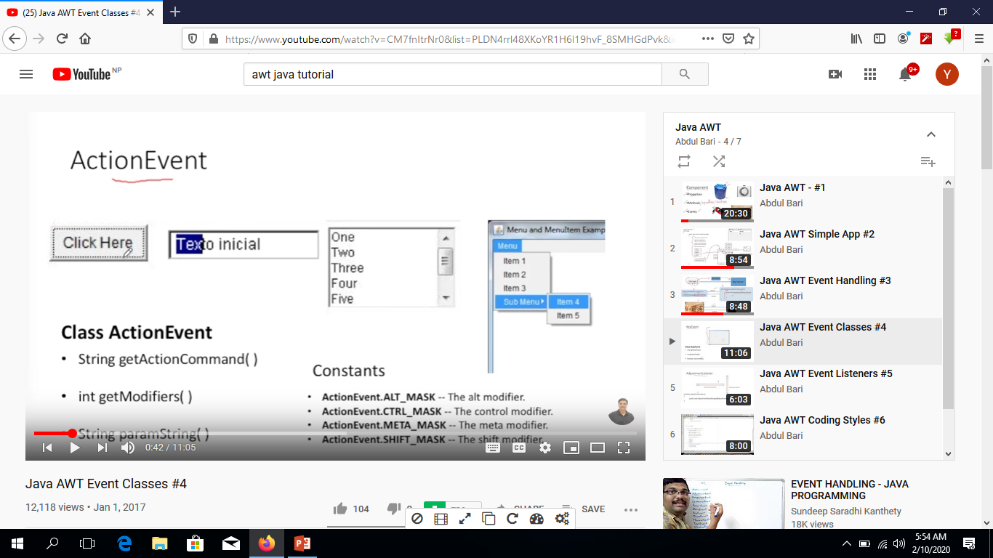
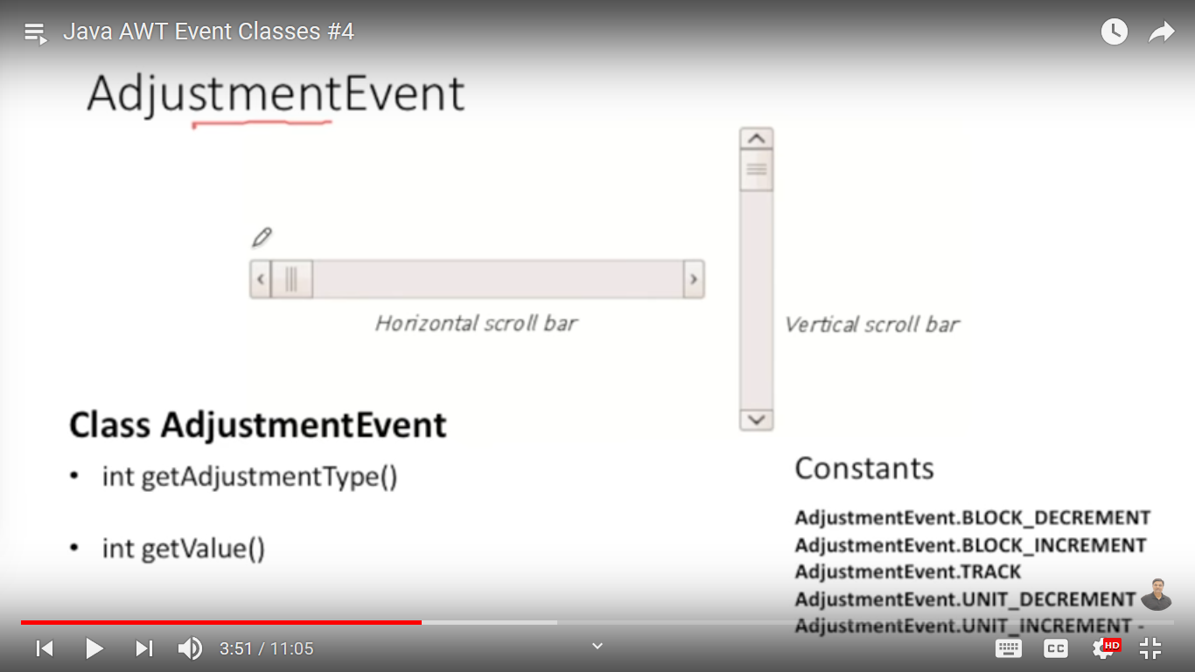
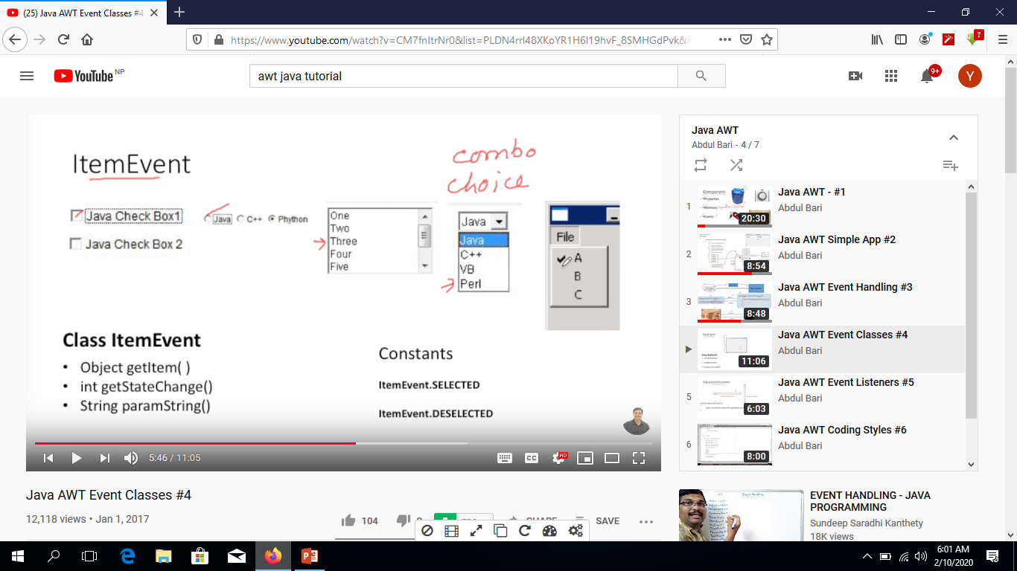

Slide 41
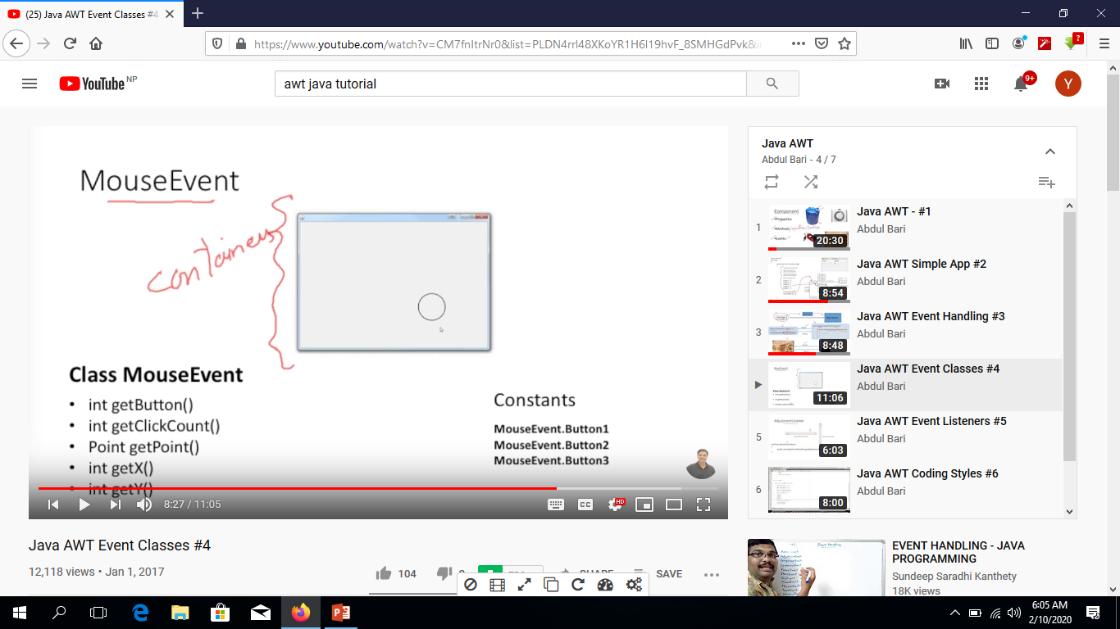
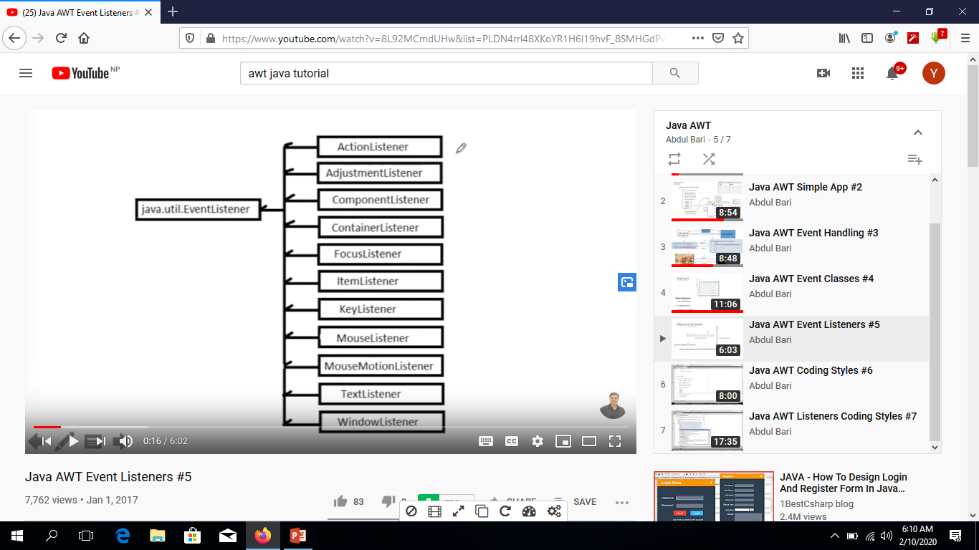
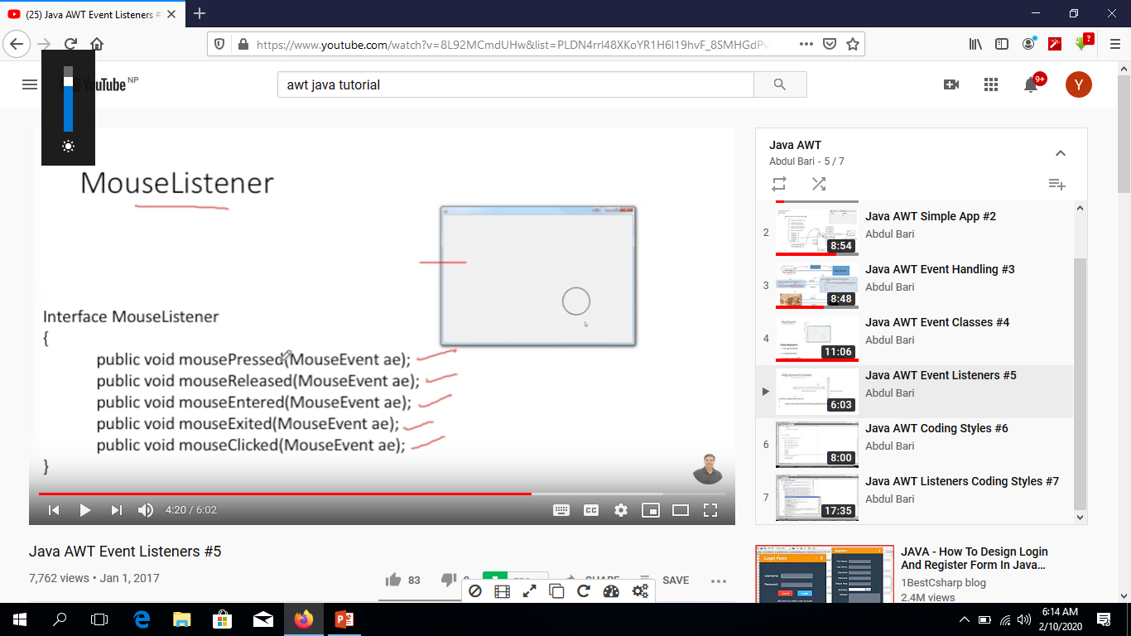

Slide 42
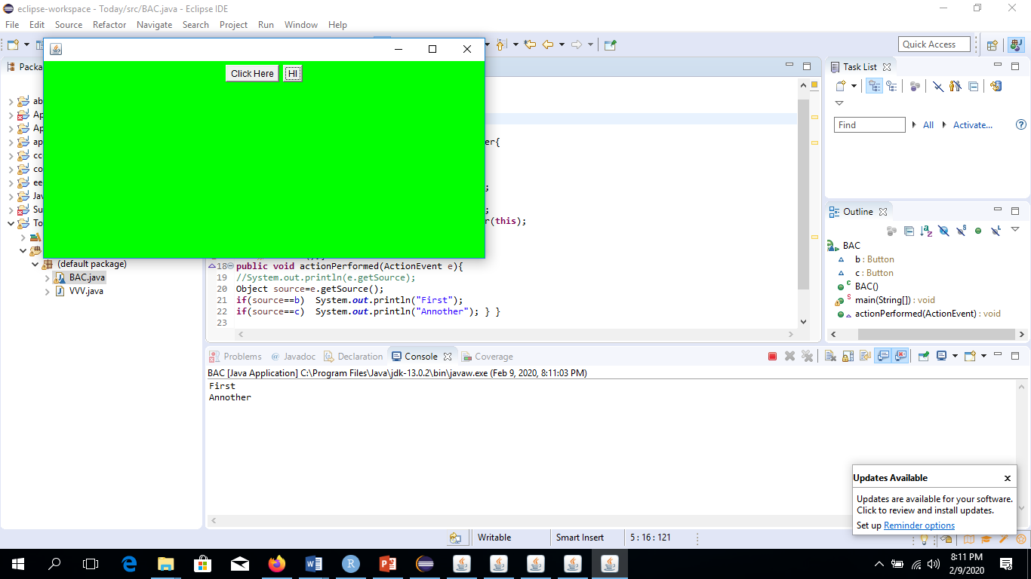
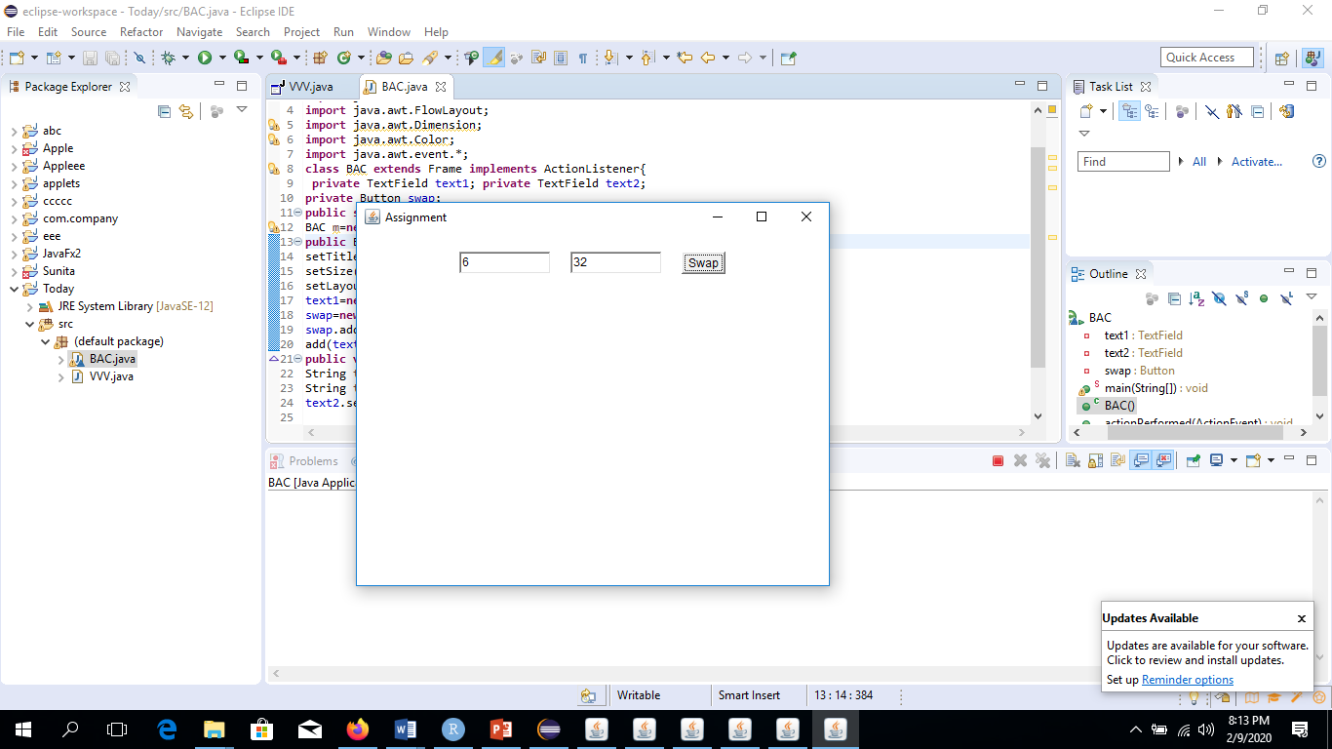
import java.awt.Button;
import java.awt.Frame;
import java.awt.FlowLayout;
import java.awt.Dimension;
import java.awt.Color;
import java.awt.event.*;
class L extends Frame implements ActionListener{
Button b,c;
public L(){
setSize(600,300); setVisible(true);
setLayout(new FlowLayout()); setLocation(50,50);
setBackground(Color.GREEN);
b=new Button("Click Here"); c=new Button("HI");
b.addActionListener(this) ; c.addActionListener(this);
add(b);add(c); }
public static void main(String[] args){
L l=new L();}
public void actionPerformed(ActionEvent e){
//System.out.println(e.getSource);
Object source=e.getSource();
if(source==b) System.out.println("First");
if(source==c) System.out.println("Annother"); } }
import java.awt.Button;
import java.awt.Frame;
import java.awt.TextField;
import java.awt.FlowLayout;
import java.awt.Dimension;
import java.awt.Color;
import java.awt.event.*;
class M extends Frame implements ActionListener{
private TextField text1; private TextField text2;
private Button swap;
public static void main(String[] args){
M m=new M(); }
public M(){
setTitle("Assignment"); setVisible(true);
setSize(500,400); setLocation(200,300);
setLayout(new FlowLayout(FlowLayout.CENTER,20,20));
text1=new TextField(10); text2=new TextField(10);
swap=new Button("Swap");
swap.addActionListener(this);
add(text1); add(text2); add(swap); }
public void actionPerformed(ActionEvent e){
String t1=text1.getText();
String t2=text2.getText();
text2.setText(t1); text1.setText(t2);} }

Slide 43
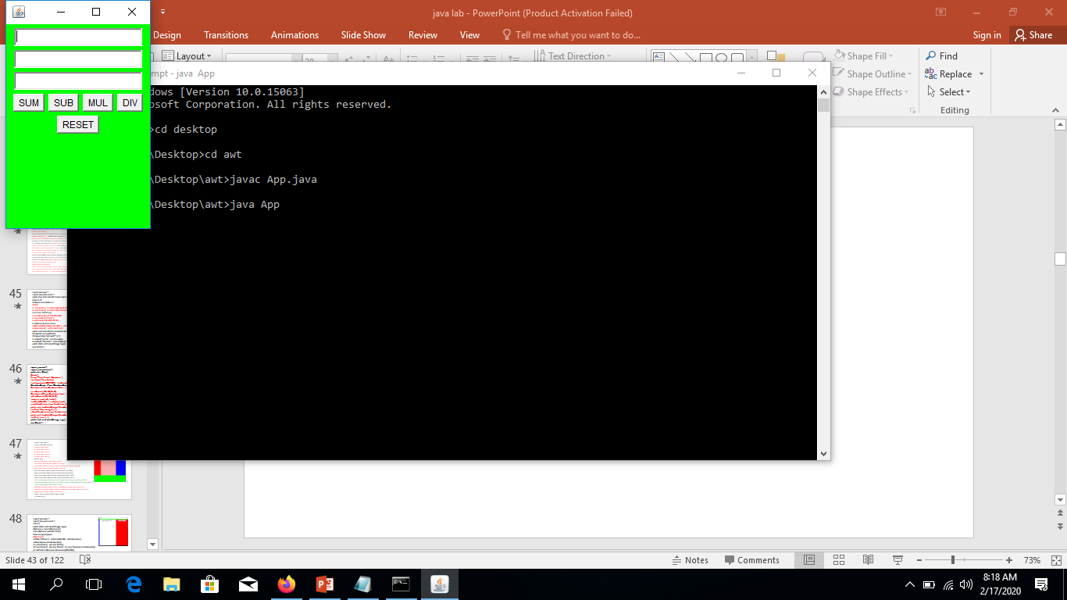

Slide 44
package A;
import java.awt.Button; import java.awt.Frame; import java.awt.TextField;
import java.awt.FlowLayout; import java.awt.Color; import java.awt.event.ActionEvent;
import java.awt.event.ActionListener;
public class MyFrame extends Frame implements ActionListener {
private TextField num1,num2,ans; private Button sum,sub,div,mul,reset;
public MyFrame(){
setSize(200,300); setVisible(true); setLayout(new FlowLayout()); setBackground(Color.GREEN); addComponents(); addActionListeners(); initialize(); }
public void actionPerformed(ActionEvent e){
String t1=num1.getText(); String t2=num2.getText(); Integer n1=Integer.parseInt(t1); Integer n2=Integer.parseInt(t2); Integer answer=0; Button bb=(Button)e.getSource();
if(bb==sum) {answer=n1+n2;} else if(bb==sub){answer=n1-n2;}
else if(bb==mul){answer=n1*n2;} else if(bb==div){answer=n1/n2;}
else {System.out.println("reset"); num1.setText(""); num2.setText("");}
ans.setText(answer.toString()); }
public void addActionListeners(){sum.addActionListener(this); sub.addActionListener(this);
mul.addActionListener(this); div.addActionListener(this); reset.addActionListener(this); }
public void addComponents(){add(num1);add(num2);add(ans);add(sum);add(sub);
add(mul);add(div);add(reset);}
public void initialize(){
num1=new TextField(20); num2=new TextField(20);ans=new TextField(20);
sum=new Button("SUM");sub=new Button("SUB"); mul=new Button("MUL");
div=new Button("DIV"); reset=new Button("RESET");}}
package A;
class App{
public static void main(String[] args){
MyFrame frame=new MyFrame(); } }
C:\Users\user\Desktop\awt>javac A/App.java
C:\Users\user\Desktop\awt>java A/App

Slide 45
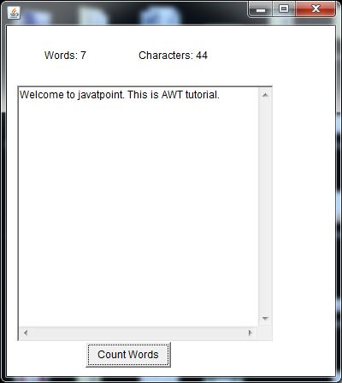
import java.awt.*;
import java.awt.event.*;
public class Text extends Frame implements ActionListener{
Label l1,l2;
TextArea area;Button b;
Text(){
l1=new Label(); l1.setBounds(50,50,100,30);
l2=new Label(); l2.setBounds(150,50,100,30);
area=new TextArea();
area.setBounds(20,100,300,300);
b=new Button("Count Words");
b.setBounds(100,400,100,30);
b.addActionListener(this);
add(l1);add(l2);add(area);add(b); setSize(400,450);
setLayout(null); setVisible(true);}
public void actionPerformed(ActionEvent e){
String text=area.getText();
String words[]=text.split("\\s");
l1.setText("words"+words.length);
l2.setText("Character"+text.length());}
public static void main(String[] args){
new Text();} }

Slide 46
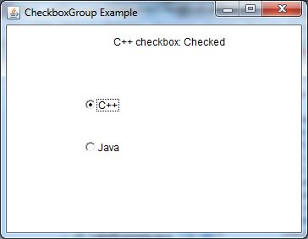
import java.awt.*;
import java.awt.event.*;
public class Check{
Check(){
Frame f=new Frame("CheckboxGroup Example");
final Label l=new Label();
l.setAlignment(l.CENTER); l.setSize(400,100);
CheckboxGroup c=new CheckboxGroup();
Checkbox cc=new Checkbox("C++",c,false);
cc.setBounds(100,100,50,50);
Checkbox cc2=new Checkbox("Java",c,false);
cc2.setBounds(100,150,50,50);
f.add(cc);f.add(cc2);f.add(l);
f.setSize(400,400); f.setLayout(null); f.setVisible(true);
cc.addItemListener(new ItemListener(){
public void itemStateChanged(ItemEvent e){
l.setText("C++ changed");}});
cc2.addItemListener(new ItemListener(){
public void itemStateChanged(ItemEvent e){
l.setText("java");}}); }
public static void main(String[] args){
new Check();} }

Slide 47
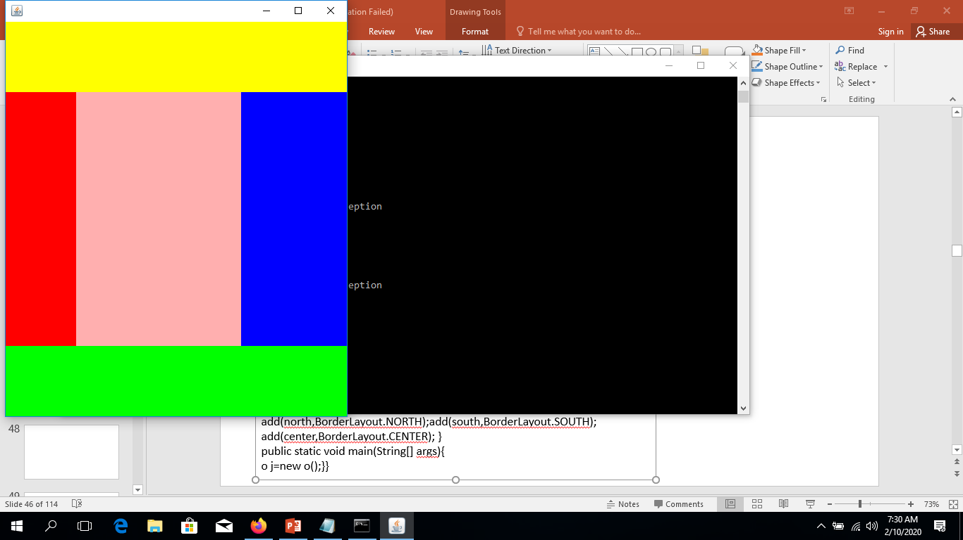
import java.awt.*;
class o extends Frame{
private Panel east;
private Panel west;
private Panel south;
private Panel center;
private Panel north;
public o(){
setSize(500,600); setVisible(true);
setLayout(new BorderLayout(10,20));
east=new Panel(); center=new Panel();west=new Panel();
north=new Panel();south=new Panel();
east.setPreferredSize(new Dimension(150,500));
west.setPreferredSize(new Dimension(100,500));
north.setPreferredSize(new Dimension(200,100));
south.setPreferredSize(new Dimension(200,100));
east.setBackground(Color.BLUE); west.setBackground(Color.RED);
north.setBackground(Color.YELLOW); south.setBackground(Color.GREEN);
center.setBackground(Color.PINK);
add(east,BorderLayout.EAST); add(west,BorderLayout.WEST);
add(north,BorderLayout.NORTH);add(south,BorderLayout.SOUTH);
add(center,BorderLayout.CENTER); }
public static void main(String[] args){
o j=new o();}}

Slide 48
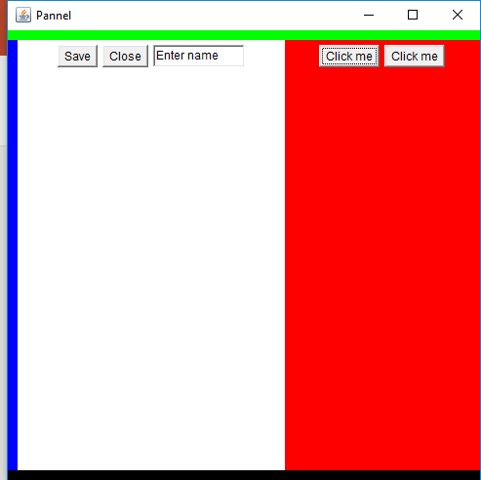
import java.awt.*;
import java.awt.event.*;
class C{
public static void main(String[] args){
MyFrame x=new MyFrame();}}
class MyFrame extends Frame{
Panel p1,p2,p3,p4,p5;
MyFrame(){
setTitle("Pannel"); setSize(500,500); setVisible(true);
setLayout(new BorderLayout());
p1=new Panel(); p2=new Panel();
p3=new Panel(); p4=new Panel(); p5=new Panel(new FlowLayout());
p1.setPreferredSize(new Dimension(200,300));
p1.add(new Button("Click me")); p1.add(new Button("Click me"));
p5.add(new Button("Save")); p5.add(new Button("Close"));
p5.add(new TextField("Enter name"));
p1.setBackground(Color.RED); p2.setBackground(Color.BLUE);
p3.setBackground(Color.GREEN); p4.setBackground(Color.BLACK);
p5.setBackground(Color.WHITE); add(p1,BorderLayout.EAST);
add(p2,BorderLayout.WEST); add(p3,BorderLayout.NORTH);
add(p4,BorderLayout.SOUTH); add(p5,BorderLayout.CENTER); }}

Slide 49
Java AWT MenuItem and Menu
The object of MenuItem class adds a simple labeled menu item on menu. The items used in a menu must belong to the MenuItem or any of its subclass.
The object of Menu class is a pull down menu component which is displayed on the menu bar. It inherits the MenuItem class.
AWT MenuItem class declaration
public class MenuItem extends MenuComponent implements Accessible
AWT Menu class declaration
public class Menu extends MenuItem implements MenuContainer, Accessible

Slide 50
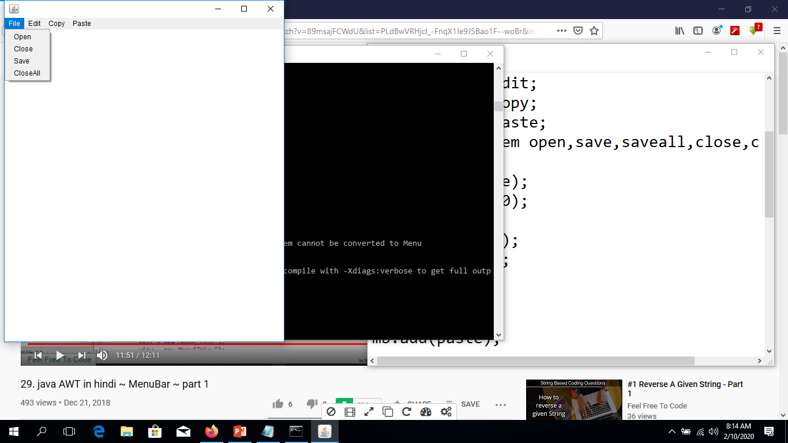
import java.awt.*;
class A{
public static void main(String[] args){
MyFrame frame=new MyFrame(); }}
class MyFrame extends Frame{
private MenuBar mb;
private Menu file; private Menu edit; private Menu copy; private Menu paste;
private MenuItem open,save,saveall,close,closeall;
MyFrame(){
setVisible(true); setSize(500,600); init();
addCompoments(); setMenuBar(mb);
mb.add(file); mb.add(edit); mb.add(copy);mb.add(paste); }
private void addCompoments(){
setMenuBar(mb);
file.add(open); file.add(close); file.add(save); file.add(closeall); }
private void init(){
mb=new MenuBar(); file=new Menu("File");
edit=new Menu("Edit"); copy=new Menu("Copy");
paste=new Menu("Paste"); save=new MenuItem("Save");
close=new MenuItem("Close"); closeall=new MenuItem("CloseAll");
open=new MenuItem("Open"); } }

Slide 51
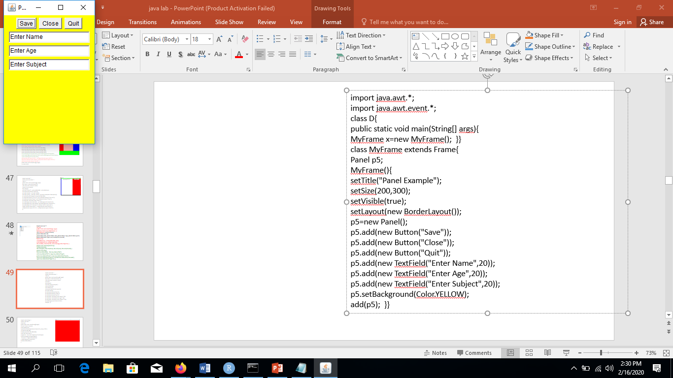
import java.awt.*;
import java.awt.event.*;
class D{
public static void main(String[] args){
MyFrame x=new MyFrame(); }}
class MyFrame extends Frame{
Panel p5;
MyFrame(){
setTitle("Panel Example");
setSize(200,300); setVisible(true);
setLayout(new BorderLayout()); p5=new Panel();
p5.add(new Button("Save"));
p5.add(new Button("Close"));
p5.add(new Button("Quit"));
p5.add(new TextField("Enter Name",20));
p5.add(new TextField("Enter Age",20));
p5.add(new TextField("Enter Subject",20));
p5.setBackground(Color.YELLOW); add(p5); }}

Slide 52
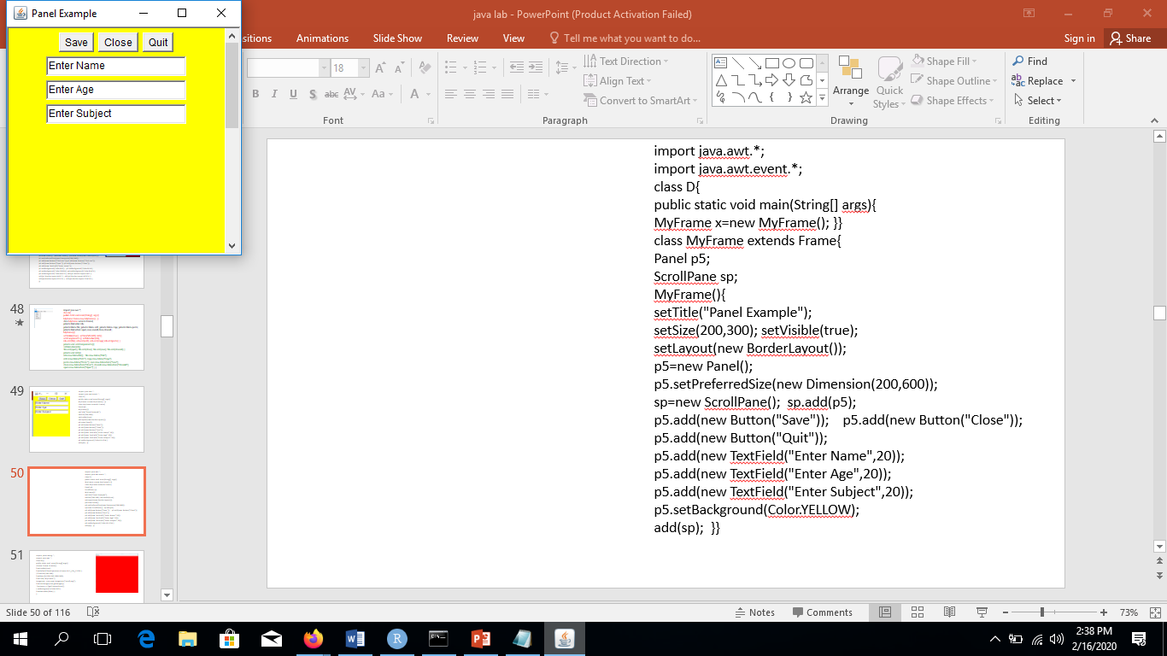
import java.awt.*;
import java.awt.event.*;
class D{
public static void main(String[] args){
MyFrame x=new MyFrame(); }}
class MyFrame extends Frame{
Panel p5; ScrollPane sp;
MyFrame(){
setTitle("Panel Example");
setSize(200,300); setVisible(true);
setLayout(new BorderLayout());
p5=new Panel();
p5.setPreferredSize(new Dimension(200,600));
sp=new ScrollPane(); sp.add(p5);
p5.add(new Button("Save")); p5.add(new Button("Close"));
p5.add(new Button("Quit"));
p5.add(new TextField("Enter Name",20));
p5.add(new TextField("Enter Age",20));
p5.add(new TextField("Enter Subject",20));
p5.setBackground(Color.YELLOW);
add(sp); }}

Slide 53
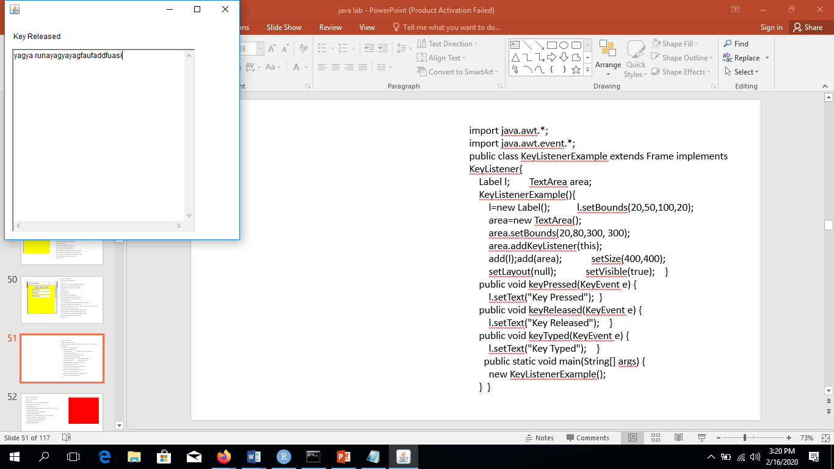
Methods of KeyListener interface
The signature of 3 methods found in KeyListener interface are given below:
public abstract void keyPressed(KeyEvent e);
public abstract void keyReleased(KeyEvent e);
public abstract void keyTyped(KeyEvent e);
import java.awt.*;
import java.awt.event.*;
public class KeyListenerExample extends Frame implements KeyListener{
Label l; TextArea area;
KeyListenerExample(){
l=new Label(); l.setBounds(20,50,100,20);
area=new TextArea();
area.setBounds(20,80,300, 300);
area.addKeyListener(this);
add(l);add(area); setSize(400,400);
setLayout(null); setVisible(true); }
public void keyPressed(KeyEvent e) {
l.setText("Key Pressed"); }
public void keyReleased(KeyEvent e) {
l.setText("Key Released"); }
public void keyTyped(KeyEvent e) {
l.setText("Key Typed"); }
public static void main(String[] args) {
new KeyListenerExample(); } }

Slide 54
Swing API is a set of extensible GUI Components to ease the developer's life to create JAVA based Front End/GUI Applications. It is build on top of AWT API and acts as a replacement of AWT API, since it has almost every control corresponding to AWT controls. Swing component follows a Model-View-Controller architecture to fulfill the following criterias.
A single API is to be sufficient to support multiple look and feel.
API is to be model driven so that the highest level API is not required to have data.
API is to use the Java Bean model so that Builder Tools and IDE can provide better services to the developers for use.
MVC Architecture
Swing API architecture follows loosely based MVC architecture in the following manner.
Model represents component's data.
View represents visual representation of the component's data.
Controller takes the input from the user on the view and reflects the changes in Component's data.
Swing component has Model as a seperate element, while the View and Controller part are clubbed in the User Interface elements. Because of which, Swing has a pluggable look-and-feel architecture.
Swing Features
Light Weight − Swing components are independent of native Operating System's API as Swing API controls are rendered mostly using pure JAVA code instead of underlying operating system calls.
Rich Controls − Swing provides a rich set of advanced controls like Tree, TabbedPane, slider, colorpicker, and table controls.
Highly Customizable − Swing controls can be customized in a very easy way as visual apperance is independent of internal representation.
Pluggable look-and-feel − SWING based GUI Application look and feel can be changed at run-time, based on available values.

Slide 55
Swing
There are many differences between java awt and swing that are given below.
AWT and Swing are two toolkits to build rich Graphical User Interfaces (GUI).
The main difference between AWT and Swing in Java is that AWT is Java's original platform dependent windowing, graphics and user interface widget toolkit while Swing is a GUI widget toolkit for Java that is an extension of AWT.
Therefore, Swing provides more sophisticated components than AWT. Here, the programmer has to import javax.swing package to write a Swing application.
This package provides a number of classes such as JButton, JTable, JList, JTextArea, and, JCheckBox
Java AWT | Java Swing
AWT components are platform-dependent. | Java swing components are platform-independent.
AWT components are heavyweight. | Swing components are lightweight.
AWT doesn't support pluggable look and feel. | Swing supports pluggable look and feel.
AWT provides less components than Swing. | Swing provides more powerful components such as tables, lists, scrollpanes, colorchooser, tabbedpane etc.
AWT doesn't follows MVC(Model View Controller) where model represents data, view represents presentation and controller acts as an interface between model and view. | Swing follows MVC.

Slide 56
Difference Between AWT and Swing
Definition
AWT is a collection of GUI components (widgets) and other related services required for GUI programming in Java. Swing is a part of Java Foundation Classes (JFC) that is used to create Java-based Front end GUI applications. Hence, this explains the main difference between AWT and Swing in Java.
Type : AWT components are heavyweight while Swing components are lightweight.
Platform Dependency
Another major difference between AWT and Swing in Java is that AWT is platform dependent while Swing is platform independent.
Display: Moreover, AWT does not support a pluggable look and feel. Swing supports a pluggable look and feel. This is also an important difference between AWT and Swing in Java.
Components: Also, Swing has more advanced components than AWT.
Speed : Furthermore, execution of AWT is slower. However, Swing executes faster.
MVC: AWT does not support Modern View Component pattern while Swing supports Data, Presentation, interface component pattern. This is another difference between AWT and Swing.
Memory Space
Moreover, AWT components require more memory space while Swing components do not require much memory space.
Package
The programmer has to import the javax.awt package to develop an AWT-based GUI. However, the programmer has to import javax.swing package to write a Swing application.

Slide 57
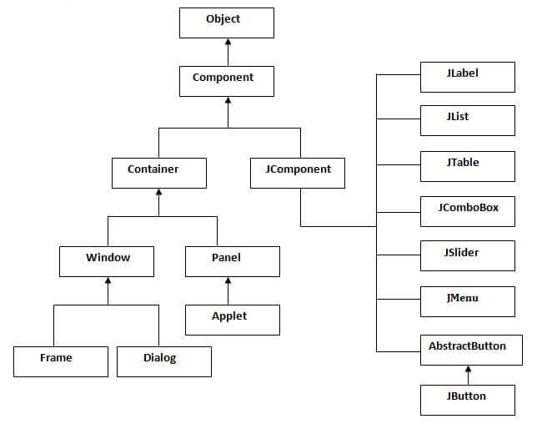

Slide 58
Method | Description
public void add(Component c) | add a component on another component.
public void setSize(int width,int height) | sets size of the component.
public void setLayout(LayoutManager m) | sets the layout manager for the component.
public void setVisible(boolean b) | sets the visibility of the component. It is by default false.
JButton class
JRadioButton class
JTextArea class
JComboBox class
JTable class
JColorChooser class
JProgressBar class
JSlider class
Digital Watch
Graphics in swing
Displaying image
Edit menu code for Notepad
OpenDialog Box
Notepad
Puzzle Game
Pic Puzzle Game
Tic Tac Toe Game
BorderLayout
GridLayout
FlowLayout
CardLayout

Slide 59
import javax.swing.*;
public class Example extends JFrame{
public Example(){}
public Example(String s){super(s);}
public static void main(String[]args){
Example jf=new Example("First Swing");
jf.setSize(300,300);
jf.setVisible(true);
jf.setDefaultCloseOperation(JFrame.EXIT_ON_CLOSE); }}
import javax.swing.*;
public class Example{
public static void main(String[]args){
JFrame jf=new JFrame("First Swing");
jf.setSize(300,300);
jf.setVisible(true);
jf.setDefaultCloseOperation(JFrame.EXIT_ON_CLOSE);
}}

Slide 60
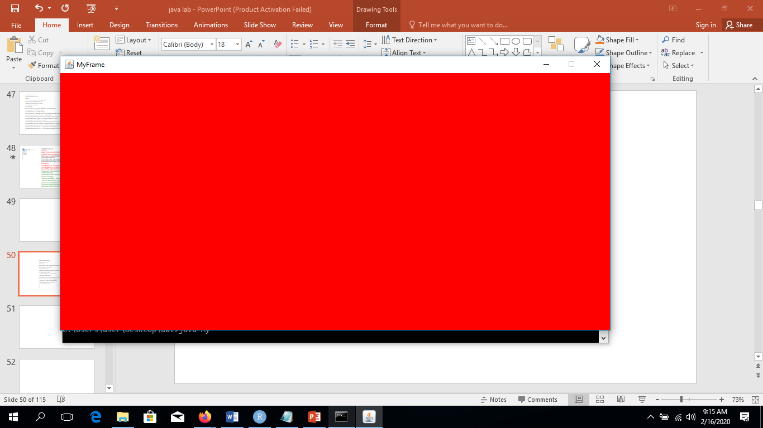
import javax.swing.*;
import java.awt.*;
class My{
public static void main(String[]args){
JFrame f=new JFrame();
f.setVisible(true);
f.setDefaultCloseOperation(JFrame.EXIT_ON_CLOSE);
//f.setSize(700,300);
f.setBounds(100,100,1000,500);
f.setTitle("MyFrame");
ImageIcon icon=new ImageIcon("small.png");
f.setIconImage(icon.getImage());
Container c=f.getContentPane();
c.setBackground(Color.RED);
f.setResizable(false); }}

Slide 61
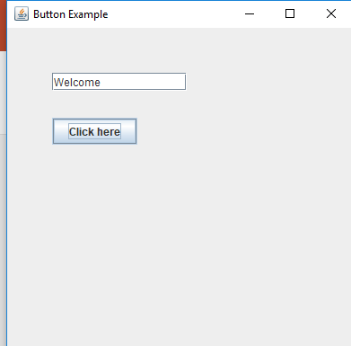
import java.awt.event.*;
import javax.swing.*;
public class ButtonExample{
public static void main(String []args){
JFrame f=new JFrame("Button Example");
final JTextField tf=new JTextField();
tf.setBounds(50,50,150,20);
JButton b=new JButton("Click here");
b.setBounds(50,100,95,30);
b.addActionListener(new ActionListener(){
public void actionPerformed(ActionEvent e){
tf.setText("Welcome");}});
f.add(b);f.add(tf);
f.setSize(400,400);
f.setLayout(null);
f.setVisible(true); }}

Slide 62
Constructor | Description
JLabel() | Creates a JLabel instance with no image and with an empty string for the title.
JLabel(String s) | Creates a JLabel instance with the specified text.
JLabel(Icon i) | Creates a JLabel instance with the specified image.
JLabel(String s, Icon i, int horizontalAlignment) | Creates a JLabel instance with the specified text, image, and horizontal alignment.

Slide 63
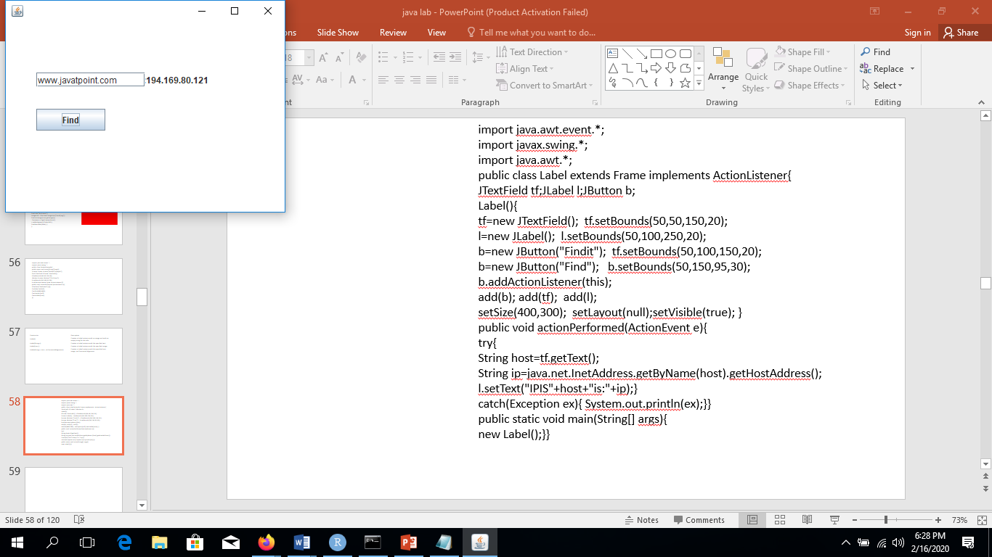
import java.awt.event.*;
import javax.swing.*;
import java.awt.*;
public class Label extends Frame implements ActionListener{
JTextField tf;JLabel l;JButton b;
Label(){
tf=new JTextField(); tf.setBounds(50,50,150,20);
l=new JLabel(); l.setBounds(50,100,250,20);
b=new JButton("Findit"); tf.setBounds(50,100,150,20);
b=new JButton("Find"); b.setBounds(50,150,95,30);
b.addActionListener(this);
add(b); add(tf); add(l);
setSize(400,300); setLayout(null);setVisible(true); }
public void actionPerformed(ActionEvent e){
try{
String host=tf.getText();
String ip=java.net.InetAddress.getByName(host).getHostAddress();
l.setText("IPIS"+host+"is:"+ip);}
catch(Exception ex){ System.out.println(ex);}}
public static void main(String[] args){
new Label();}}

Slide 64
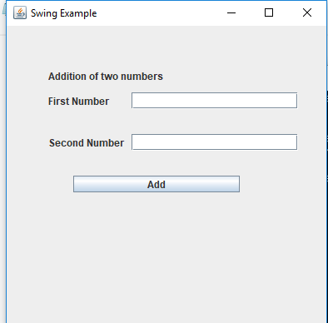
package javafxdemo;
import javax.swing.*;
import java.awt.event.*;
public class Example extends JFrame{
JLabel l1,l2,l3,l4; JTextField t1,t2; JButton b1;
public Example(){}
public Example(String s){ super(s);}
public void setComponents(){ l1=new JLabel("Addition of two numbers");
l2=new JLabel("First Number"); l3=new JLabel("Second Number");
l4=new JLabel(); t1=new JTextField(); t2=new JTextField();
b1=new JButton("Add"); setLayout(null);
l1.setBounds(50,50,200,20); l2.setBounds(50,80,200,20);
t1.setBounds(150,80,200,20); l3.setBounds(50,130,200,20);
t2.setBounds(150,130,200,20); b1.setBounds(80,180,200,20); l4.setBounds(100,240,200,20); b1.addActionListener(new Handler());
add(l1);add(l2);add(t1); add(l3);add(t2);add(b1);add(l4);}
class Handler implements ActionListener{
public void actionPerformed(ActionEvent e){
int a=Integer.parseInt(t1.getText());int b=Integer.parseInt(t2.getText());
int k=a+b; l4.setText("Result "+k);}}
public static void main(String[] args){
Example jf=new Example("Swing Example");
jf.setComponents(); jf.setSize(400,400); jf.setVisible(true);
jf.setDefaultCloseOperation(JFrame.EXIT_ON_CLOSE); }}

Slide 65
import javax.swing.*;
import java.awt.Color.*;
class MyFrame extends JFrame{
public static void main(String[] args){
JFrame frame=new JFrame();
frame.setVisible(true);
frame.setDefaultCloseOperation(JFrame.EXIT_ON_CLOSE);
frame.setSize(700,500);
frame.setLocation(100,50);
frame.setBounds(100,100,200,300);
frame.setTitle("My title");
ImageIcon ico=new ImageIcon("icon.png");
frame.setIconImage(ico.getImage());
}}
import javax.swing.JFrame;
import java.awt.Color;
public class ColoredFrame {
public static void main( String[] args ) {
JFrame frame = new JFrame( "TestFrame" );
frame.getContentPane().setBackground( Color.PINK );
frame.setSize( 200, 200 );
frame.setVisible( true );
//frame.setResizable(false);
frame.setDefaultCloseOperation( JFrame.EXIT_ON_CLOSE ); }}

Slide 66
import javax.swing.*;
import java.awt.*;
public class ColoredFrame {
public static void main( String[] args ) {
JFrame frame = new JFrame("TestFrame");
frame.setVisible( true );
frame.setDefaultCloseOperation(JFrame.EXIT_ON_CLOSE );
frame.setBounds(100,100,1000,500);
Container c=frame.getContentPane();
c.setLayout(null);
JLabel label=new JLabel("Enter name");
label.setText("Password");
label.setBounds(100,50,100,30);
Font f=new Font("Aerial",Font.BOLD,30);
label.setFont(f);
c.add(label); }}
import javax.swing.*;
import java.awt.*;
public class ColoredFrame {
public static void main( String[] args ) {
JFrame frame = new JFrame("TestFrame");
frame.setVisible( true );
frame.setDefaultCloseOperation(JFrame.EXIT_ON_CLOSE );
frame.setBounds(100,100,1000,500);
Container c=frame.getContentPane();
c.setLayout(null);
ImageIcon icon=new ImageIcon("handd.PNG");
JLabel label=new JLabel(icon);
label.setBounds(100,50,icon.getIconWidth(),icon.getIconHeight());
c.add(label);}}

Slide 67
class CurrentThreadDemo {
public static void main(String args[]) {
Thread t = Thread.currentThread();
System.out.println("Current thread: " + t);
// change the name of the thread
t.setName("My Thread");
System.out.println("After name change: " + t);
try {
for(int n = 5; n > 0; n--) {
System.out.println(n);
Thread.sleep(1000);}
} catch (InterruptedException e) {
System.out.println("Main thread interrupted");
} } }
class NewThread implements Runnable {
Thread t;
NewThread() { // Create a new, second thread
t = new Thread(this, "Demo Thread");
System.out.println("Child thread: " + t);
t.start(); }
// This is the entry point for the second thread.
public void run() {
try { for(int i = 5; i > 0; i--) {
System.out.println("Child Thread: " + i);
Thread.sleep(500); }
} catch (InterruptedException e) {
System.out.println("Child interrupted."); }
System.out.println("Exiting child thread.");} }
class ThreadDemo {
public static void main(String args[]) {
new NewThread(); // create a new thread
try { for(int i = 5; i > 0; i--) {
System.out.println("Main Thread: " + i);
Thread.sleep(1000); }
} catch (InterruptedException e) {
System.out.println("Main thread interrupted.");}
System.out.println("Main thread exiting."); } }

Slide 68
import javax.swing.*;
import java.awt.*;
public class ABC {
public static void main( String[] args ) {
JFrame frame = new JFrame("TestFrame");
frame.setVisible( true );
frame.setDefaultCloseOperation(JFrame.EXIT_ON_CLOSE );
frame.setBounds(100,100,1000,500);
Container c=frame.getContentPane();
c.setLayout(null);
ImageIcon icon=new ImageIcon("handd.PNG");
JLabel label=new JLabel("Text",icon,JLabel.LEFT);
label.setBounds(100,50,200,300 );
c.add(label);
}}

Slide 69
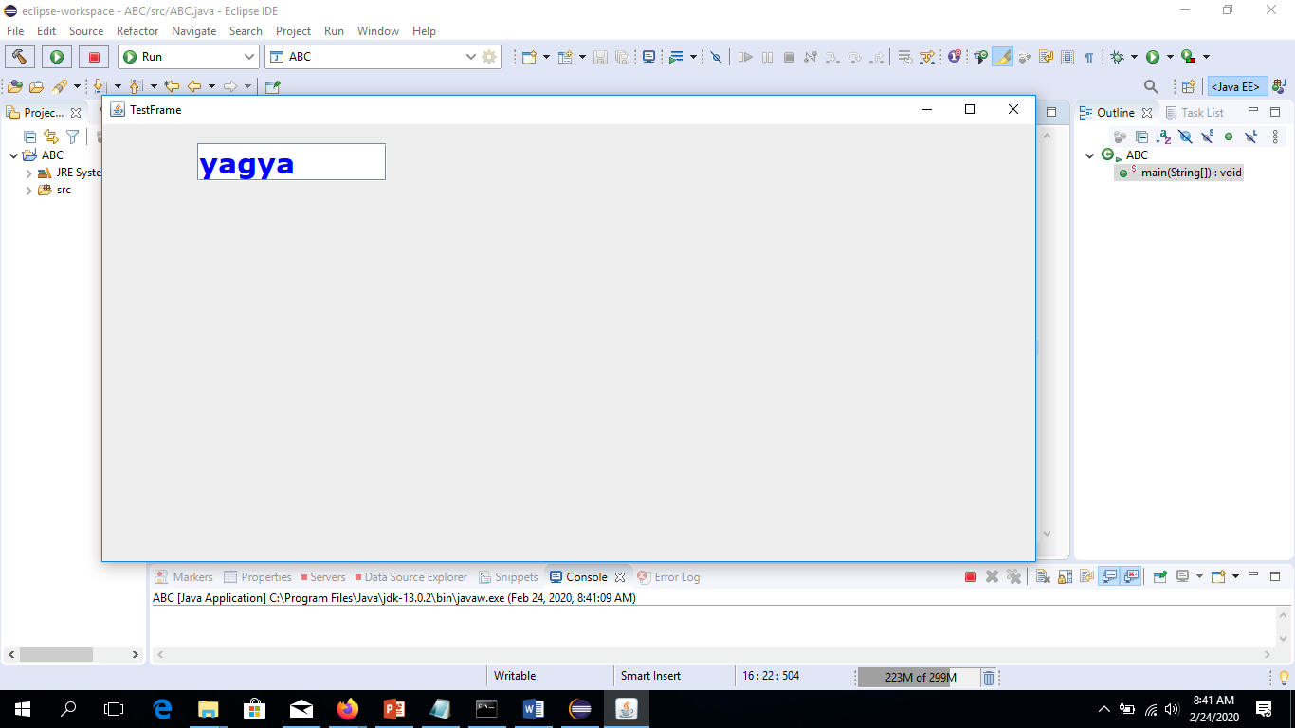
import javax.swing.*;
import java.awt.*;
import java.awt.Font;
public class ABC {
public static void main( String[] args ) {
JFrame frame = new JFrame("TestFrame");
frame.setVisible( true );
frame.setDefaultCloseOperation(JFrame.EXIT_ON_CLOSE );
frame.setBounds(100,100,1000,500);
Container c=frame.getContentPane();
c.setLayout(null);
JTextField mytext=new JTextField();
mytext.setBounds(100,20,200,40);
c.add(mytext);
Font font = new Font("Verdana", Font.BOLD, 30);
mytext.setFont(font);
mytext.setForeground(Color.BLUE);
c.add(mytext); }}

Slide 70
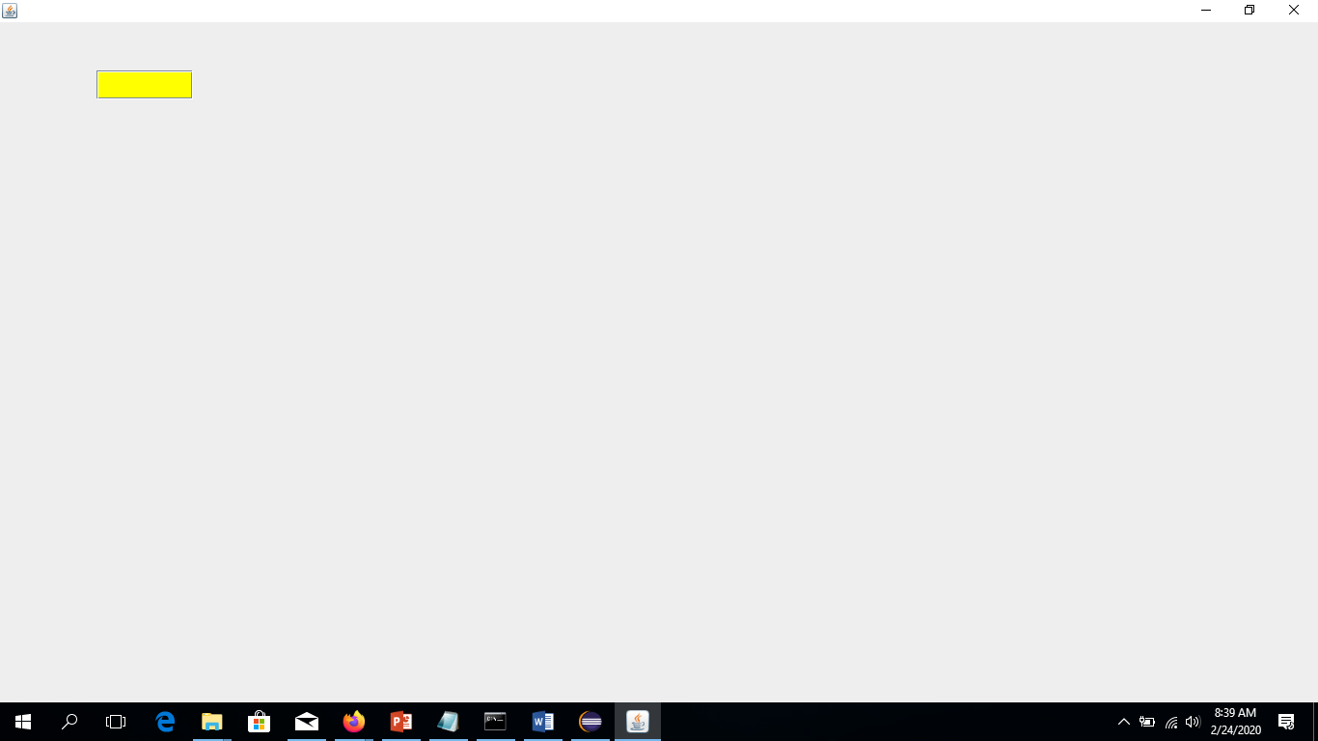
import java.awt.*;
import javax.swing.*;
class MyPassword{
public static void main(String[] args){
JFrame frame=new JFrame();
frame.setVisible(true);
frame.setDefaultCloseOperation(JFrame.EXIT_ON_CLOSE);
frame.setBounds(100,100,1000,500);
Container c=frame.getContentPane();
c.setLayout(null);
JPasswordField pass=new JPasswordField();
pass.setBounds(100,50,100,30);
Font f =new Font("Arial",Font.BOLD,30);
pass.setFont(f);
pass.setBackground(Color.YELLOW);
pass.setForeground(Color.RED);
c.add(pass); }}
import java.awt.*;
import javax.swing.*;
class MyFrame extends JFrame{
JButton btn=new JButton("Click");
Container c;
MyFrame(){
c=this.getContentPane();
c.setLayout(null);
btn.setBounds(100,50,100,50);
c.add(btn);} }
class ActionDemo{
public static void main(String[] args){
MyFrame f=new MyFrame();
f.setTitle("Action Demo");
f.setVisible(true);
f.setDefaultCloseOperation(JFrame.EXIT_ON_CLOSE);
f.setBounds(100,50,70,100);
}}

Slide 71
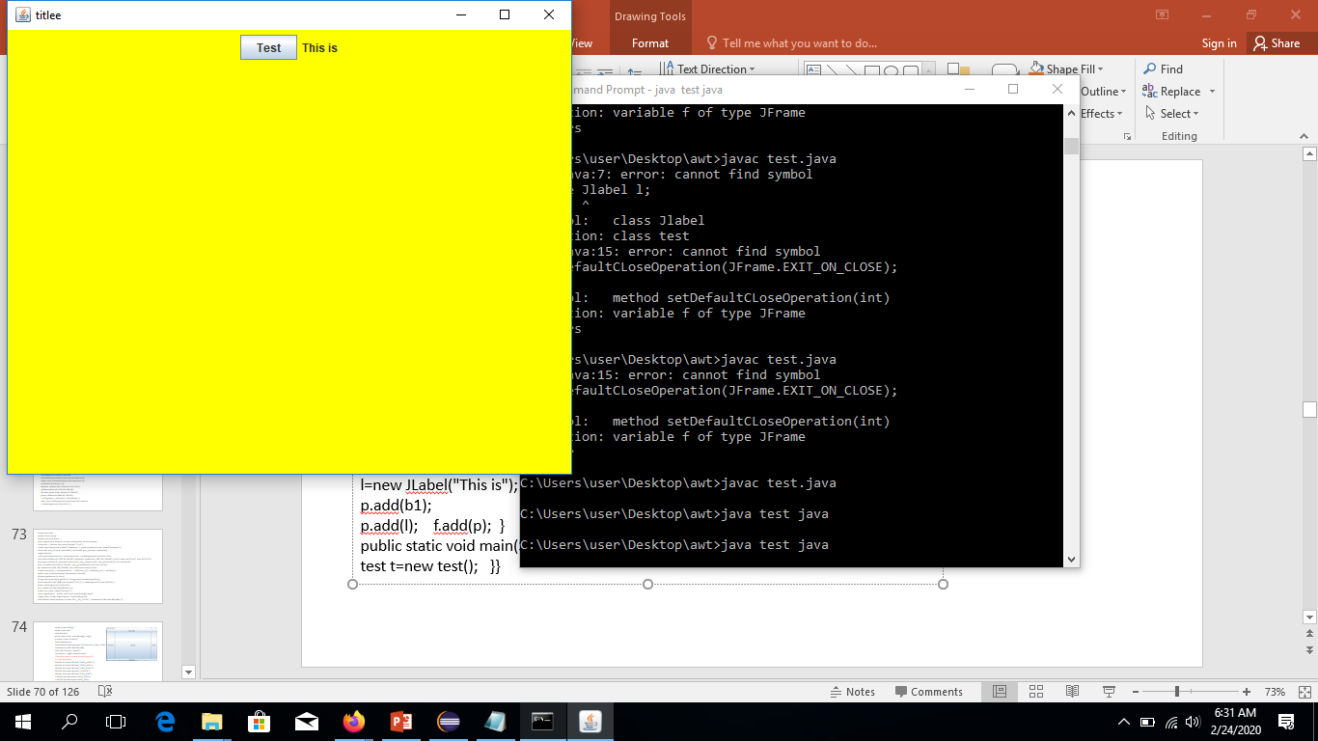
import javax.swing.*;
import java.awt.*;
public class test{
private JFrame f; private JPanel p;
private JButton b1; private JLabel l;
public test(){ gui(); }
public void gui(){
f=new JFrame("titlee");
f.setVisible(true);
f.setSize(600,499);
f.setDefaultCloseOperation(JFrame.EXIT_ON_CLOSE);
p= new JPanel();
p.setBackground(Color.YELLOW);
b1=new JButton("Test");
l=new JLabel("This is");
p.add(b1); p.add(l); f.add(p);
//f.add(p,Borderlayout.SOUTH); }
public static void main(String [] args){
test t=new test(); }}

Slide 72
import java.awt.*;
import javax.swing.*;
import java.awt.event.*;
class Actiondemo2{
static Container c;
public static void main(String[] args){
JFrame frame=new JFrame("Action Demo Using Anonymous Inner");
frame.setVisible(true);
frame.setDefaultCloseOperation(JFrame.EXIT_ON_CLOSE);
frame.setBounds(200,100,500,30);
c=frame.getContentPane();
c.setBackground(Color.YELLOW);c.setLayout(null);
JButton red=new JButton("RED");
red.setBounds(100,50,100,50);
red.addActionListener(new ActionListener(){
public void actionPerformed(ActionEvent e){
redButtonAction(e); } });
JButton yellow=new JButton("YELLOW"); yellow.setBounds(250,50,100,50);
JButton green=new JButton("GREEN"); green.setBounds(400,50,100,50);
c.add(green);c.add(red);c.add(yellow); }
static void redButtonAction(ActionEvent event){
c.setBackground(Color.RED);} }

Slide 73
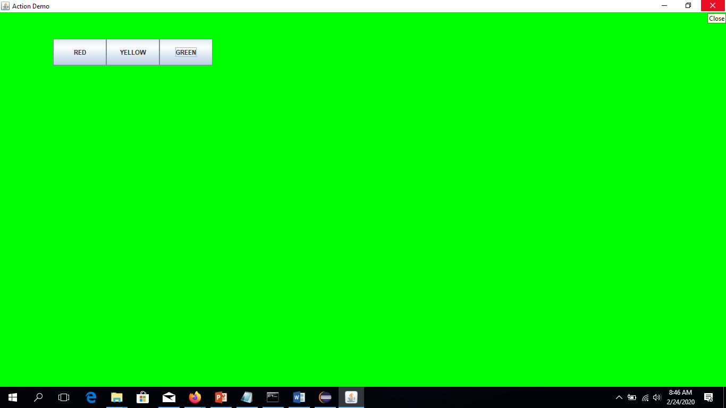
import java.awt.*;
import javax.swing.*;
import java.awt.event.*;
class MyFrame extends JFrame implements ActionListener{
JButton btn1=new JButton("RED"); JButton btn2=new JButton("YELLOW");
JButton btn3=new JButton("GREEN");
Container c;
MyFrame(){ c=this.getContentPane(); c.setLayout(null);
btn1.setBounds(100,50,100,50); btn2.setBounds(200,50,100,50);
btn3.setBounds(300,50,100,50);
btn1.addActionListener(this);
btn2.addActionListener(this);
btn3.addActionListener(this);
c.add(btn1);c.add(btn2);c.add(btn3);}
public void actionPerformed(ActionEvent e){
if(e.getSource()==btn1){c.setBackground(Color.RED);}
if(e.getSource()==btn2){c.setBackground(Color.YELLOW);}
if(e.getSource()==btn3){c.setBackground(Color.GREEN);} }}
class ActionDemo{
public static void main(String[] args){
MyFrame f=new MyFrame();
f.setTitle("Action Demo"); f.setVisible(true);
f.setDefaultCloseOperation(JFrame.EXIT_ON_CLOSE);
f.setBounds(100,50,70,100); }}

Slide 74
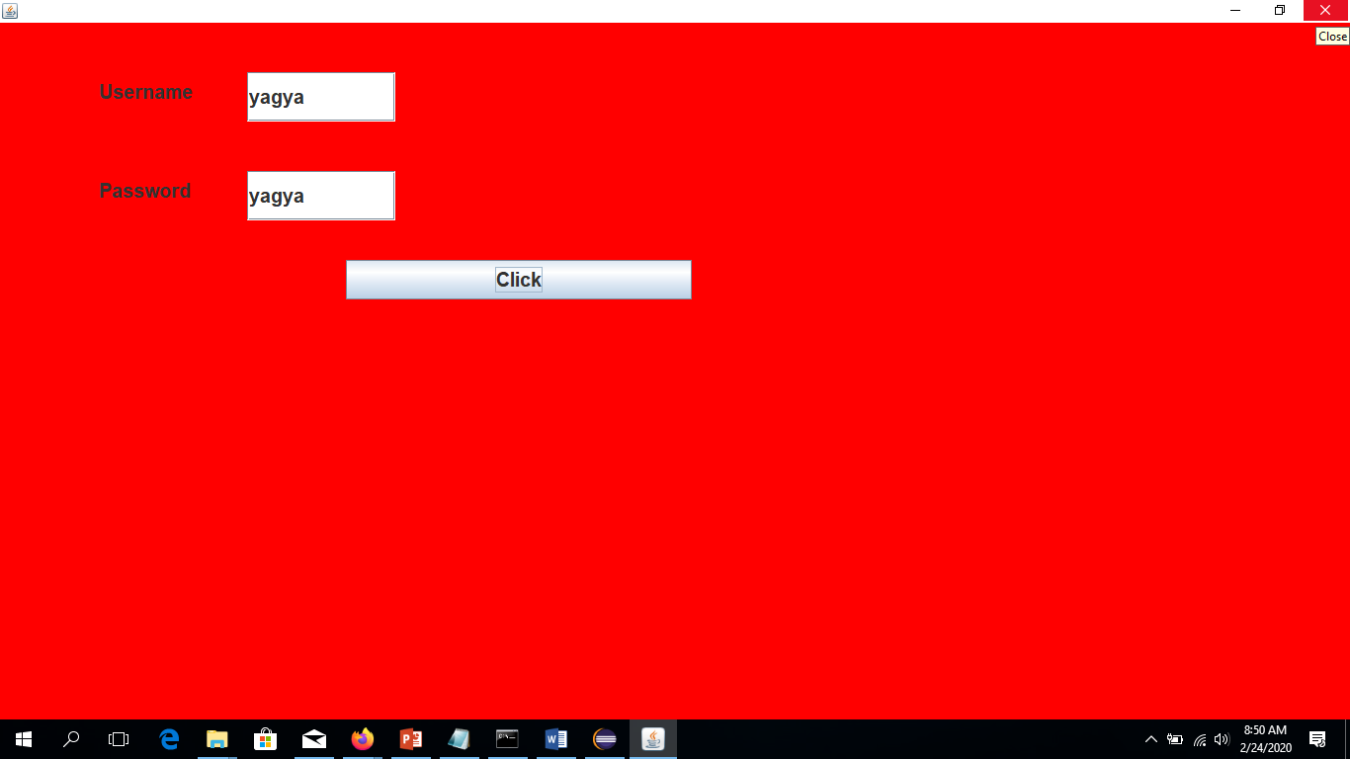
import java.awt.*;
import javax.swing.*;
import java.awt.event.*;
class LoginFrame extends JFrame implements ActionListener{
Container c; JButton btn=new JButton("Click");
JLabel username=new JLabel("Username"); JLabel password=new JLabel("Password");
JTextField user_tf=new JTextField(); JTextField user_pf=new JTextField();
LoginFrame(){
c=this.getContentPane(); c.setLayout(null); c.setBackground(Color.YELLOW);
username.setBounds(100,50,100,40); password.setBounds(100,150,100,40); Font f=new Font("Arial",Font.BOLD,20); username.setFont(f); password.setFont(f); user_tf.setFont(f); user_pf.setFont(f); btn.setFont(f);
user_tf.setBounds(250,50,150,50); user_pf.setBounds(250,150,150,50);
btn.setBounds(350,240,350,40); btn.addActionListener(this);
c.add(username); c.add(password); c.add(user_tf); c.add(user_pf); c.add(btn);}
public void actionPerformed(ActionEvent event){
if(event.getSource()==btn){
String user=username.getText(); String pass=password.getText();
if(user.equals("ABC")&& pass.equals("123")) { c.setBackground(Color.GREEN); }
else{c.setBackground(Color.RED);
wrn.setBounds(300,300,400,40);} }}
JLabel wrn=new JLabel("Wrong"); }
class LoginDemo{
public static void main(String[] args){
LoginFrame f=new LoginFrame(); f.setVisible(true);
f.setDefaultCloseOperation(JFrame.EXIT_ON_CLOSE); f.setBounds(200,100,500,300); }}

Slide 75
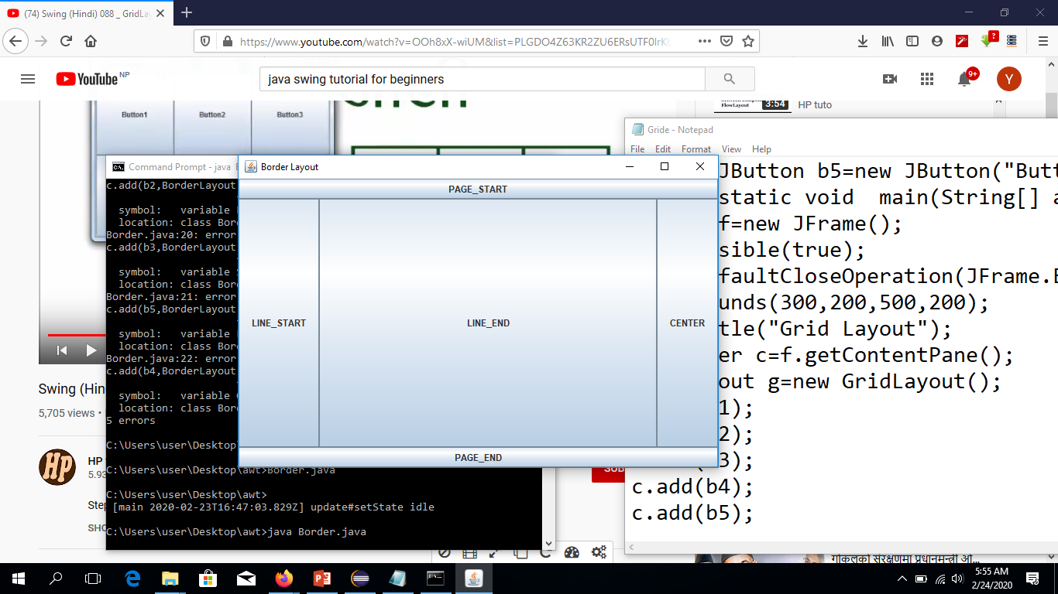
import javax.swing.*;
import java.awt.*;
class Border{
public static void main(String[] args){
JFrame f=new JFrame();
f.setVisible(true);
f.setDefaultCloseOperation(JFrame.EXIT_ON_CLOSE);
f.setBounds(300,200,500,200);
f.setTitle("Border Layout");
Container c=f.getContentPane();
//BorderLayout bl=new BorderLayout();
//c.setLayout(bl);
JButton b1=new JButton("PAGE_START");
JButton b2=new JButton("PAGE_END");
JButton b3=new JButton("LINE_START");
JButton b4=new JButton("CENTER");
JButton b5=new JButton("LINE_END");
c.add(b1,BorderLayout.PAGE_START);
c.add(b2,BorderLayout.PAGE_END);
c.add(b3,BorderLayout.LINE_START);
c.add(b5,BorderLayout.CENTER);
//c.add(b4,BorderLayout.LINE_END); }}

Slide 76
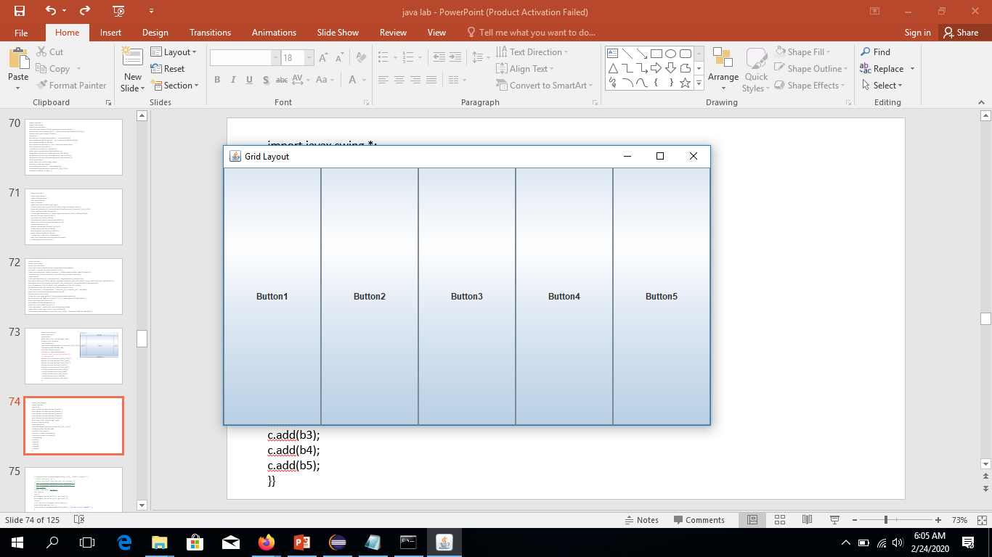
import javax.swing.*;
import java.awt.*;
class Grid{
static JButton b1=new JButton("Button1");
static JButton b2=new JButton("Button2");
static JButton b3=new JButton("Button3");
static JButton b4=new JButton("Button4");
static JButton b5=new JButton("Button5");
public static void main(String[] args){
JFrame f=new JFrame();
f.setVisible(true);
f.setDefaultCloseOperation(JFrame.EXIT_ON_CLOSE);
f.setBounds(300,200,500,200);
f.setTitle("Grid Layout");
Container c=f.getContentPane();
GridLayout g=new GridLayout();
c.setLayout(g); c.add(b1); c.add(b2);c.add(b3);
c.add(b4); c.add(b5); }}

Slide 77
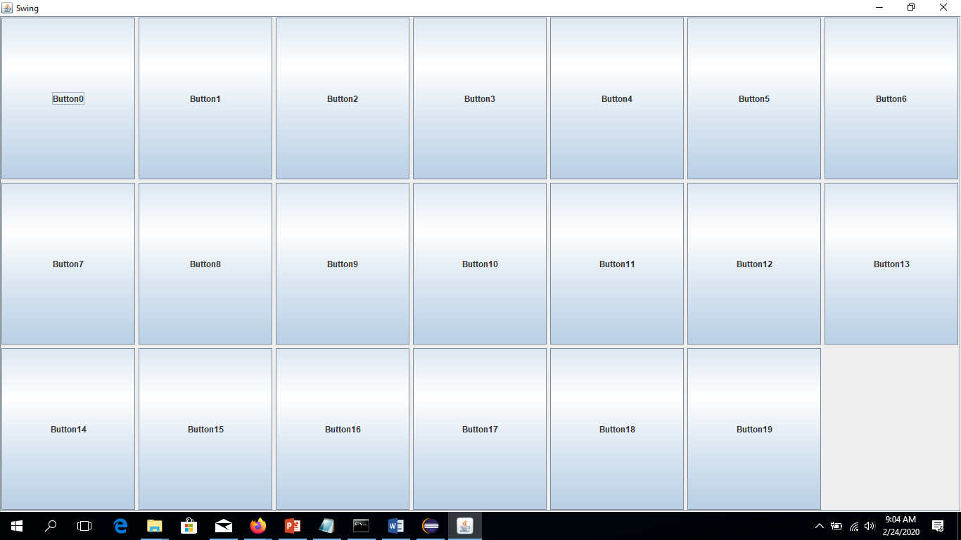
import javax.swing.JFrame;
import javax.swing.JPanel;
import javax.swing.JScrollPane;
import javax.swing.JButton;
import javax.swing.WindowConstants;
import java.awt.GridLayout;
public class ABC{
public ABC() {
JFrame f=new JFrame("Swing");
f.setSize(300,400);
f.setDefaultCloseOperation(WindowConstants.EXIT_ON_CLOSE);
JPanel p=new JPanel(new GridLayout(3,2,5,5));
for(int i=0;i<20;i++) {
p.add("Button"+i,new JButton("Button"+i));}
JScrollPane s=new JScrollPane(p);
f.setContentPane(s);
f.setVisible(true);}
public static void main(String[] args) {
new ABC();
} }

Slide 78
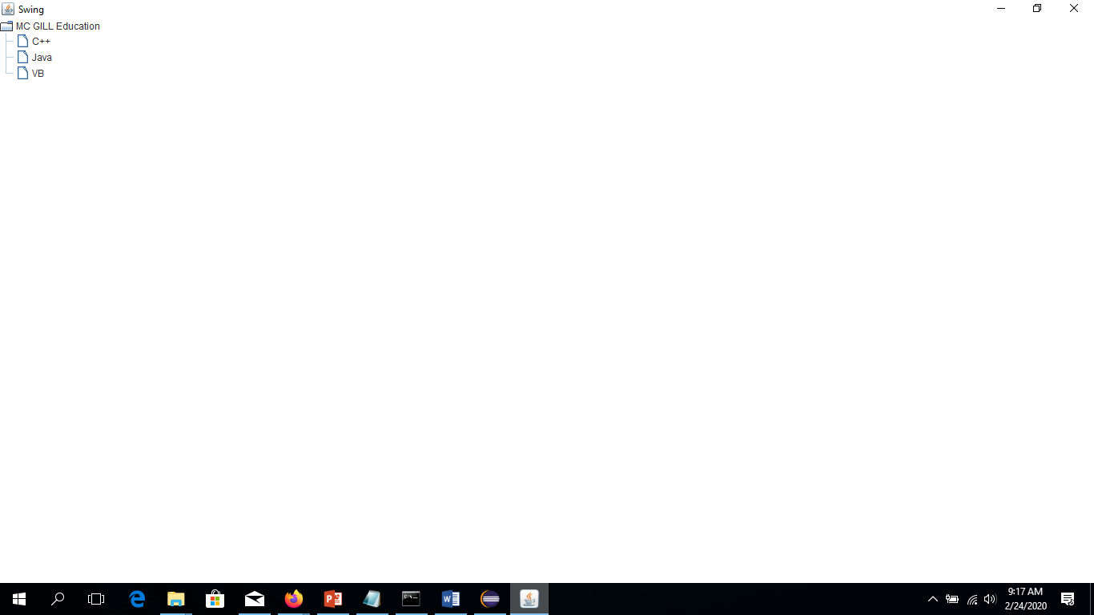
import javax.swing.JFrame;
import javax.swing.WindowConstants;
import javax.swing.JTree;
import javax.swing.tree.DefaultMutableTreeNode;
import javax.swing.tree.DefaultTreeSelectionModel;
import javax.swing.tree.TreeSelectionModel;
import java.awt.GridLayout;
public class ABC{
public ABC() {
JFrame f=new JFrame("Swing");
f.setSize(300,400);
f.setDefaultCloseOperation(WindowConstants.EXIT_ON_CLOSE);
DefaultMutableTreeNode tn=new DefaultMutableTreeNode("MC GILL Education");
DefaultMutableTreeNode one=new DefaultMutableTreeNode("C++");
DefaultMutableTreeNode two=new DefaultMutableTreeNode("Java");
DefaultMutableTreeNode three=new DefaultMutableTreeNode("VB");
tn.add(one); tn.add(two);tn.add(three);
JTree t=new JTree(tn);
t.getSelectionModel().setSelectionMode(TreeSelectionModel.SINGLE_TREE_SELECTION);
f.setContentPane(t); f.setVisible(true);}
public static void main(String[] args) {
new ABC(); } }

Slide 79
Using WindowBuilder
Installed add software
https://download.eclipse.org/windowbuilder/latest/
//JOptionPane.showMessageDialog(null, "Hello student");
//lbl1.setText("HI");
//txt1.setText("How are you be prepare");
//int k=Integer.parseInt(txt1.getText());
//int b=Integer.parseInt(txt2.getText());
//int y=k+b;
//lbl1.setText("Ap"+y);
int a,b,c;
try {
a=Integer.parseInt(txt1.getText());
b=Integer.parseInt(txt2.getText());
c=a+b;
txt3.setText(Integer.toString(c));
}catch(Exception e1) {
JOptionPane.showMessageDialog(null, "Please Enter Number"); }

Slide 80
JavaFx
A media/graphics framework for creating GUIs in java application.
JavaFx is interceded to replace swing the standard GUI library for Java SE.
More powerful.
Used to create both desktop and web application
Like swing draws its own components, less communication with Operating System.
Light weight and hardware accelerated.
Makes use of FXML and XML markup languages for defining UI controls.
JavaFX is a Java library used to build Rich Internet Applications.
Can run consistently across multiple platforms such as Desktop Computers, Mobile Phones, TVs, Tablets, etc.

Slide 81
Features of JavaFX
Written in Java − The JavaFX library is written in Java and is available for the languages that can be executed on a JVM, which include − Java, Groovy and JRuby.
These JavaFX applications are also platform independent.
FXML − JavaFX features a language known as FXML, which is a HTML like declarative markup language. The sole purpose of this language is to define a user Interface.
Scene Builder − JavaFX provides an application named Scene Builder. On integrating this application in IDE’s such as Eclipse and NetBeans, the users can access a drag and drop design interface, which is used to develop FXML applications (just like Swing Drag & Drop and DreamWeaver Applications).
Swing Interoperability − In a JavaFX application, you can embed Swing content using the Swing Node class. Similarly, you can update the existing Swing applications with JavaFX features like embedded web content and rich graphics media.
Built-in UI controls − JavaFX library caters UI controls using which we can develop a full-featured application.
CSS like Styling − JavaFX provides a CSS like styling. By using this, you can improve the design of your application with a simple knowledge of CSS.

Slide 82
Canvas and Printing API − JavaFX provides Canvas, an immediate mode style of rendering API. Within the package javafx.scene.canvas it holds a set of classes for canvas, using which we can draw directly within an area of the JavaFX scene. JavaFX also provides classes for Printing purposes in the package javafx.print.
Rich set of API’s − JavaFX library provides a rich set of API’s to develop GUI applications, 2D and 3D graphics, etc. This set of API’s also includes capabilities of Java platform.
Therefore, using this API, you can access the features of Java languages such as Generics, Annotations, Multithreading, and Lambda Expressions. The traditional Java Collections library was enhanced and concepts like observable lists and maps were included in it. Using these, the users can observe the changes in the data models.
Integrated Graphics library − JavaFX provides classes for 2d and 3d graphics.
Graphics pipeline − JavaFX supports graphics based on the Hardware-accelerated graphics pipeline known as Prism. When used with a supported Graphic Card or GPU it offers smooth graphics. In case the system does not support graphic card then prism defaults to the software rendering stack.

Slide 83
History
First announced in May 2007 and released in December 2008
originally it was brought as responsible to flash and shockwave.
But also improve ease of creating GUIs for java Applications
Latest release is javafx 11
More advance window than all
Oracle provides javafx scene builder
Ability to apply css on the components of UI for better looking applications
Supports 3D supports

Slide 84
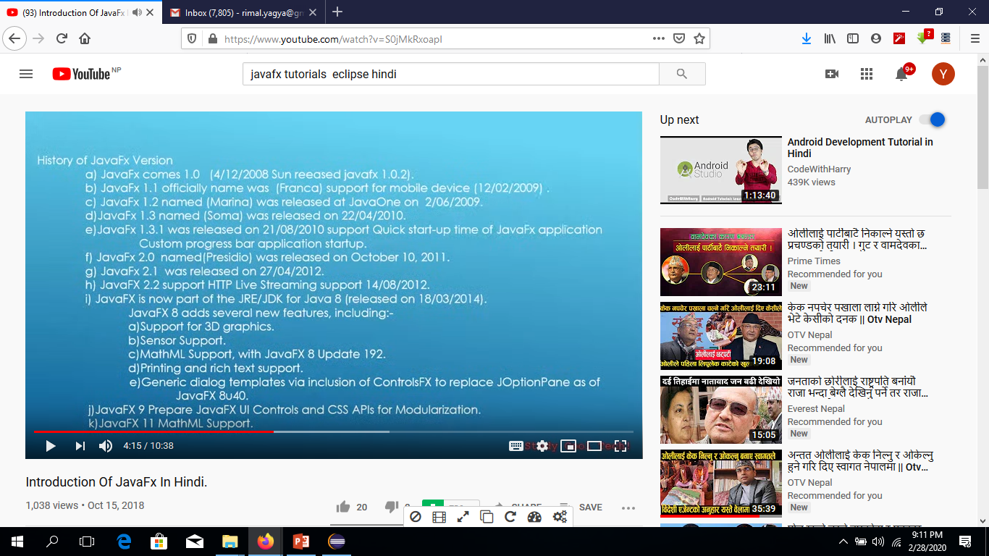

Slide 85
Javafx script supports FXML which supports declarative FXML and XML.
GUI are created faster than swing and awt,Sophisticated and aesthetically pleasing,Easy integration of sounds images views and web contents.
Codes are simples

Slide 86
JavaFX provides a complete API with a rich set of classes and interfaces to build GUI applications with rich graphics. The important packages of this API are −
javafx.animation − Contains classes to add transition based animations such as fill, fade, rotate, scale and translation, to the JavaFX nodes.
javafx.application − Contains a set of classes responsible for the JavaFX application life cycle.
javafx.css − Contains classes to add CSS–like styling to JavaFX GUI applications.
javafx.event − Contains classes and interfaces to deliver and handle JavaFX events.
javafx.geometry − Contains classes to define 2D objects and perform operations on them.
javafx.stage − This package holds the top level container classes for JavaFX application.
javafx.scene − This package provides classes and interfaces to support the scene graph. In addition, it also provides sub-packages such as canvas, chart, control, effect, image, input, layout, media, paint, shape, text, transform, web, etc. There are several components that support this rich API of JavaFX.

Slide 87
Stage javafx.stage window
Scene jsvafx.scene
Stackpane
Visits
Button btn

Slide 88
Another way
Go to help
Select installed software
Paste link https://download.eclipse.org/efxclipse/updates-released/1.2.0/site/
Click Add button then
name depositary
e(fx)clipse
Select all click next next
Accept license terms condition click finished from internet
Restarted
Then select new project select javafx
Give name select src file main.java ad css file will be there
Main template with few code will be there
Installed javafx in eclipse
Create new project give name
Go to project create new class hello .java
Right click project Go to properties
Go to built path select library
Remove and add library and jre system library
Click finished once again add library
Select user library click nest
Add new library
Name javafx click ok
Click external jar then select java folder
Select jdk
Select jre then lib folder
Jfxswt.jar
Click open then ok
Ok

Slide 89
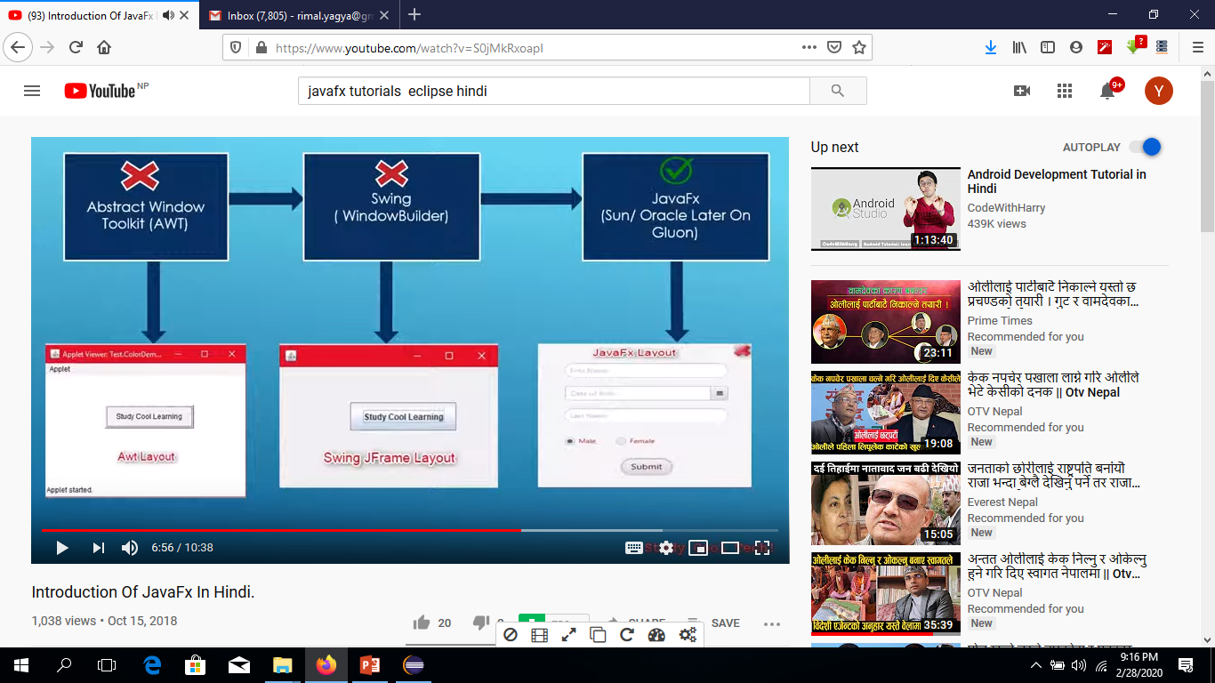

Slide 90


Slide 91


Slide 92


Slide 93

import javafx.application.Application;
import javafx.scene.Scene;
import javafx.scene.control.Button;
import javafx.scene.layout.StackPane;
import javafx.stage.Stage;
import javafx.event.*;
public class Main extends Application {
public void start(Stage primaryStage) {
Button b=new Button(); b.setText("HOw are you");
b.setOnAction(new EventHandler<ActionEvent>() {
public void handle(ActionEvent event) {
System.out.println("Hello BE Prepare For Examination");
} });
StackPane root=new StackPane();
root.getChildren().add(b);
Scene scene=new Scene(root,200,300);
primaryStage.setTitle("how are you");
primaryStage.setScene(scene); primaryStage.show(); }
public static void main(String args[]){
launch(args); } }

Slide 94

import javafx.application.Application; import javafx.geometry.Insets;
import javafx.geometry.Pos; import javafx.scene.Scene;
import javafx.scene.control.Button; import javafx.scene.control.PasswordField;
import javafx.scene.layout.GridPane; import javafx.scene.text.Text;
import javafx.scene.control.TextField; import javafx.stage.Stage;
public class Main extends Application { @Override
public void start(Stage stage) { //creating label email
Text text1 = new Text("Email"); //creating label password
Text text2 = new Text("Password"); //Creating Text Filed for email
TextField textField1 = new TextField(); //Creating Text Filed for password
PasswordField textField2 = new PasswordField(); //Creating Buttons
Button button1 = new Button("Submit");
Button button2 = new Button("Clear"); //Creating a Grid Pane
GridPane gridPane = new GridPane(); //Setting size for the pane
gridPane.setMinSize(400, 200); //Setting the padding
gridPane.setPadding(new Insets(10, 10, 10, 10));
//Setting the vertical and horizontal gaps between the columns
gridPane.setVgap(5); gridPane.setHgap(5); //Setting the Grid alignment
gridPane.setAlignment(Pos.CENTER); //Arranging all the nodes in the grid
gridPane.add(text1, 0, 0); gridPane.add(textField1, 1, 0);
gridPane.add(text2, 0, 1); gridPane.add(textField2, 1, 1);
gridPane.add(button1, 0, 2); gridPane.add(button2, 1, 2); //Styling nodes
button1.setStyle("-fx-background-color: darkslateblue; -fx-text-fill: white;");
button2.setStyle("-fx-background-color: darkslateblue; -fx-text-fill: white;");
text1.setStyle("-fx-font: normal bold 20px 'serif' ");
text2.setStyle("-fx-font: normal bold 20px 'serif' ");
gridPane.setStyle("-fx-background-color: BEIGE;"); // Creating a scene object
Scene scene = new Scene(gridPane); // Setting title to the Stage
stage.setTitle("CSS Example"); // Adding scene to the stage
stage.setScene(scene); stage.show(); }
public static void main(String args[]){ launch(args); } }

Slide 95
2D Shape
In general, a 2D shape is a geometrical figure that can be drawn on the XY plane, these include Line, Rectangle, Circle, etc.
Using the JavaFX library, you can draw
Predefined shapes such as Line, Rectangle, Circle, Ellipse, Polygon, Polyline, Cubic Curve, Quad Curve, Arc.
Path elements such as MoveTO Path Element, Line, Horizontal Line, Vertical Line, Cubic Curve, Quadratic Curve, Arc.
In addition to these, you can also draw a 2D shape by parsing SVG path.
Each of the above mentioned 2D shape is represented by a class and all these classes belongs to the package javafx.scene.shape.
The class named Shape is the base class of all the 2-Dimensional shapes in JavaFX.

Slide 96

package application;
import javafx.application.Application;
import javafx.scene.Group;
import javafx.scene.Scene;
import javafx.scene.shape.Line;
import javafx.stage.Stage;
public class Main extends Application{ @Override
public void start(Stage stage) {
Line line = new Line();
line.setStartX(100.0); line.setStartY(150.0);
line.setEndX(500.0); line.setEndY(150.0);
Group root = new Group(line);
Scene scene = new Scene(root, 600, 300);
stage.setTitle("Sample application");
stage.setScene(scene);
stage.show(); }
public static void main(String args[]){
launch(args); } }

Slide 97

package application;
import javafx.application.Application;
import javafx.scene.Group;
import javafx.scene.Scene;
import javafx.stage.Stage;
import javafx.scene.shape.Circle;
public class Main extends Application {
@Override
public void start(Stage stage) { //Drawing a Circle
Circle circle = new Circle();
circle.setCenterX(300.0f);circle.setCenterY(135.0f); circle.setRadius(100.0f);
Group root = new Group(circle);
Scene scene = new Scene(root, 600, 300);
stage.setTitle("Drawing a Circle");
stage.setScene(scene); stage.show(); }
public static void main(String args[]){
launch(args); } }

Slide 98
package application;
import javafx.application.Application;
import javafx.scene.Group;
import javafx.scene.Scene;
import javafx.stage.Stage;
import javafx.scene.shape.Rectangle;
public class Main extends Application {
@Override
public void start(Stage stage) {
Rectangle rectangle = new Rectangle();
rectangle.setX(150.0f); rectangle.setY(75.0f);
rectangle.setWidth(300.0f); rectangle.setHeight(150.0f);
rectangle.setArcWidth(30.0); rectangle.setArcHeight(20.0);
Group root = new Group(rectangle);
Scene scene = new Scene(root, 600, 300);
stage.setTitle("Drawing a Rectangle");
stage.setScene(scene);stage.show(); }
public static void main(String args[]){
launch(args); } }

Slide 99

package application;
import javafx.application.Application;
import javafx.scene.Group;
import javafx.scene.Scene;
import javafx.scene.paint.Color;
import javafx.stage.Stage;
import javafx.scene.shape.Circle;
import javafx.scene.shape.Shape;
public class Main extends Application {
public void start(Stage stage) {
Circle circle1 = new Circle();
circle1.setCenterX(250.0f);circle1.setCenterY(135.0f); circle1.setRadius(100.0f);
circle1.setFill(Color.DARKSLATEBLUE);
Circle circle2 = new Circle();
circle2.setCenterX(350.0f); circle2.setCenterY(135.0f); circle2.setRadius(100.0f);
circle2.setFill(Color.BLUE);
Shape shape = Shape.intersect(circle1, circle2);
shape.setFill(Color.DARKSLATEBLUE);
Group root = new Group(shape);
Scene scene = new Scene(root, 600, 300);
stage.setTitle("Intersection Example");
stage.setScene(scene); stage.show(); }
public static void main(String args[]){
launch(args); } }

Slide 100

package application;
import javafx.application.Application;
import javafx.scene.Group;
import javafx.scene.Scene;
import javafx.stage.Stage;
import javafx.scene.text.Font;
import javafx.scene.text.FontPosture;
import javafx.scene.text.FontWeight;
import javafx.scene.text.Text;
public class Main extends Application { @Override
public void start(Stage stage) {
Text text = new Text();
text.setFont(Font.font("verdana", FontWeight.BOLD, FontPosture.REGULAR, 20));
text.setY(130);
text.setText("Hi how are you");
Group root = new Group(text);
Scene scene = new Scene(root, 600, 300);
stage.setTitle("Setting Font to the text");
stage.setScene(scene); stage.show(); }
public static void main(String args[]){
launch(args); } }

Slide 101

package application;
import javafx.application.Application;
import javafx.scene.Group;
import javafx.scene.Scene;
import javafx.scene.paint.Color;
import javafx.stage.Stage;
import javafx.scene.text.Font;
import javafx.scene.text.FontPosture;
import javafx.scene.text.FontWeight;
import javafx.scene.text.Text;
public class Main extends Application { @Override
public void start(Stage stage) {
Text text = new Text();
text.setFont(Font.font("verdana", FontWeight.BOLD, FontPosture.REGULAR, 50));
text.setX(50); text.setY(130);
text.setFill(Color.BROWN); text.setStrokeWidth(2);
text.setStroke(Color.BLUE); text.setText("Hi how are you");
Group root = new Group(text);
Scene scene = new Scene(root, 600, 300);
stage.setTitle("Setting font to the text");
stage.setScene(scene); stage.show(); }
public static void main(String args[]){
launch(args); } }

Slide 102
package application;
import javafx.animation.RotateTransition;
import javafx.application.Application;
import javafx.scene.Group; import javafx.scene.Scene;
import javafx.scene.paint.Color; import javafx.scene.shape.Rectangle;
import javafx.scene.transform.Rotate;
import javafx.stage.Stage;
import javafx.util.Duration;
public class Main extends Application{ @Override
public void start(Stage primaryStage) throws Exception {
Rectangle rect = new Rectangle(200,100,200,200);
rect.setFill(Color.LIMEGREEN); rect.setStroke(Color.HOTPINK); rect.setStrokeWidth(5);
RotateTransition rotate = new RotateTransition(); rotate.setAxis(Rotate.Z_AXIS);
rotate.setByAngle(360); rotate.setCycleCount(500);
rotate.setDuration(Duration.millis(1000)); rotate.setAutoReverse(true);
rotate.setNode(rect); rotate.play(); Group root = new Group();
root.getChildren().add(rect);
Scene scene = new Scene(root,600,400,Color.BLACK);
primaryStage.setScene(scene);
primaryStage.setTitle("Rotate Transition example");
primaryStage.show(); }
public static void main(String[] args) {
launch(args); } }

Slide 103
package application;
import javafx.animation.TranslateTransition;
import javafx.application.Application;
import javafx.scene.Group;
import javafx.scene.Scene;
import javafx.scene.paint.Color;
import javafx.scene.shape.Circle;
import javafx.stage.Stage;
import javafx.util.Duration;
public class Main extends Application{ @Override
public void start(Stage primaryStage) throws Exception {
Circle cir = new Circle(50,100,50);
cir.setFill(Color.RED); cir.setStroke(Color.BLACK);
TranslateTransition translate = new TranslateTransition();
translate.setByX(400); translate.setDuration(Duration.millis(1000));
translate.setCycleCount(500); translate.setAutoReverse(true);
translate.setNode(cir); translate.play();
Group root = new Group(); root.getChildren().addAll(cir);
Scene scene = new Scene(root,500,200,Color.WHEAT);
primaryStage.setScene(scene);
primaryStage.setTitle("Translate Transition example");
primaryStage.show();}
public static void main(String[] args) {
launch(args); } }

Slide 104
Download Scene Builder
https://gluonhq.com/products/scene-builder/
Installed .msi
Open Eclipse select window
Select preferences
Select javafx
Browse location form program file to scenebuider.exe
inside javafx application
Select new FXML Document
Create give name finished
Right click view scan builder

Slide 105
package application;
import javafx.application.Application;
import javafx.scene.Group;
import javafx.scene.Scene;
import javafx.scene.chart.LineChart;
import javafx.scene.chart.NumberAxis;
import javafx.scene.chart.XYChart;
import javafx.stage.Stage;
public class Main extends Application { @Override
public void start(Stage primaryStage) throws Exception {
final NumberAxis xaxis = new NumberAxis(2008,2018,1);
final NumberAxis yaxis = new NumberAxis(10,80,5);
xaxis.setLabel("Year"); yaxis.setLabel("Price");
LineChart lineChart2 = new LineChart(xaxis,yaxis);
LineChart<?, ?> linechart = lineChart2;
@SuppressWarnings("rawtypes")
XYChart.Series series = new XYChart.Series();
series.setName("Stock Analysis");
series.getData().add(new XYChart.Data(2009,25));
series.getData().add(new XYChart.Data(2010,30));
series.getData().add(new XYChart.Data(2011,50));
series.getData().add(new XYChart.Data(2012,60));
linechart.getData().add(series);
Group root = new Group(linechart);
Scene scene = new Scene(root,600,400);
primaryStage.setScene(scene);
primaryStage.setTitle("LineChart Example");
primaryStage.show(); }
public static void main(String[] args) {
launch(args); } }

Slide 106
import java.io.OutputStreamWriter;
import java.io.PrintWriter;
import java.net.Socket;
public class Clinet {
public static void main(String[] args)throws Exception {
String ip="localhost";
int port=9999;//0-1023-65535
Socket s=new Socket(ip,port);
String str="Yagya Rimal";
OutputStreamWriter os=new OutputStreamWriter(s.getOutputStream());
//PrintWriter out=new PrintWriter(os);
os.write(str);
os.flush(); } }

Slide 107
import java.io.BufferedReader;
import java.io.InputStreamReader;
import java.net.Socket;
import java.net.ServerSocket;
public class Server {
public static void main(String[] args)throws Exception {
System.out.println("Server Started");
ServerSocket ss=new ServerSocket(9999);
System.out.println("Server Waiting");
Socket s=ss.accept();
System.out.println("Client Connected");
BufferedReader br=new BufferedReader(new InputStreamReader(s.getInputStream()));
String str=br.readLine();
System.out.println("Client data"+str);
}}

Slide 108


Slide 109


Slide 110


Slide 111
package application;
import javafx.application.Application;
import javafx.fxml.FXMLLoader;
import javafx.stage.Stage;
import javafx.scene.Parent;
import javafx.scene.Scene;
public class Main extends Application {
@Override
public void start(Stage primaryStage) {
try {
Parent root=FXMLLoader.load(getClass().getResource("/line.fxml"));
Scene scene = new Scene(root,400,400);
scene.getStylesheets().add(getClass().getResource("application.css").toExternalForm());
primaryStage.setScene(scene);
primaryStage.show();
} catch(Exception e) {
e.printStackTrace();
}
}
public static void main(String[] args) {
launch(args);
}
}
package application;
import javafx.event.ActionEvent;
import javafx.fxml.FXML;
import javafx.scene.chart.LineChart;
import javafx.scene.chart.XYChart;
public class MainController {
@FXML
LineChart<String, Number> linechart;
public void btn(ActionEvent event){
XYChart.Series<String,Number>series=new XYChart.Series<String,Number>();
series.getData().add(new XYChart.Data<String,Number>("Jan",200));
series.getData().add(new XYChart.Data<String,Number>("Feb",350));
series.getData().add(new XYChart.Data<String,Number>("March",420));
series.getData().add(new XYChart.Data<String,Number>("April",550));
linechart.getData().add(series);
}
}

Slide 112


Slide 113


Slide 114
package application;
import javafx.event.ActionEvent;
import javafx.fxml.FXML;
import javafx.fxml.FXMLLoader;
import javafx.scene.Parent;
import javafx.scene.Scene;
import javafx.scene.control.Label;
import javafx.scene.control.TextField;
import javafx.stage.Stage;
public class MainController {
@FXML
private Label lblmessage;
@FXML
private TextField txtusername;
@FXML
private TextField txtpassword;
public void Login(ActionEvent event)throws Exception{
if((txtusername.getText().equals("user")) && (txtpassword.getText().equals("pass"))){
lblmessage.setText("Login Success");
Stage primaryStage=new Stage();
Parent root=FXMLLoader.load(getClass().getResource("/application/Main.fxml"));
//BorderPane root = new BorderPane();
Scene scene = new Scene(root,400,400);
scene.getStylesheets().add(getClass().getResource("application.css").toExternalForm());
primaryStage.setScene(scene);
primaryStage.show();
}
else
lblmessage.setText("Login not");
}
}
package application;
import javafx.application.Application;
import javafx.fxml.FXMLLoader;
import javafx.stage.Stage;
import javafx.scene.Parent;
import javafx.scene.Scene;
public class Main extends Application {
@Override
public void start(Stage primaryStage) {
try {
Parent root=FXMLLoader.load(getClass().getResource("/application/Login.fxml"));
//BorderPane root = new BorderPane();
Scene scene = new Scene(root,400,400);
scene.getStylesheets().add(getClass().getResource("application.css").toExternalForm());
primaryStage.setScene(scene);
primaryStage.show();
} catch(Exception e) {
e.printStackTrace();
}
}
public static void main(String[] args) {
launch(args);
}
}

Slide 115
<?xml version="1.0" encoding="UTF-8"?>
<?import javafx.scene.control.Button?>
<?import javafx.scene.control.Label?>
<?import javafx.scene.control.PasswordField?>
<?import javafx.scene.control.TextField?>
<?import javafx.scene.layout.AnchorPane?>
<?import javafx.scene.text.Font?>
<AnchorPane prefHeight="413.0" prefWidth="372.0" xmlns="http://javafx.com/javafx/11.0.1" xmlns:fx="http://javafx.com/fxml/1" fx:controller="application.MainController">
<children>
<Button layoutX="124.0" layoutY="240.0" mnemonicParsing="false" onAction="#Login" text="Login">
<font>
<Font size="24.0" />
</font>
</Button>
<Label id="lblmessage" fx:id="lblmessage" layoutX="110.0" layoutY="55.0" prefHeight="57.0" prefWidth="101.0" text="Status" textFill="#bf0c0c">
<font>
<Font size="24.0" />
</font>
</Label>
<PasswordField id="txtpassword" fx:id="txtpassword" layoutX="38.0" layoutY="175.0" promptText="Password">
<font>
<Font size="24.0" />
</font>
</PasswordField>
<TextField id="txtusername" fx:id="txtusername" layoutX="38.0" layoutY="112.0" promptText="username">
<font>
<Font size="24.0" />
</font>
</TextField>
</children>
</AnchorPane>
<?xml version="1.0" encoding="UTF-8"?>
<?import javafx.scene.control.Label?>
<?import javafx.scene.image.Image?>
<?import javafx.scene.image.ImageView?>
<?import javafx.scene.layout.AnchorPane?>
<?import javafx.scene.text.Font?>
<AnchorPane prefHeight="300.0" prefWidth="300.0" xmlns="http://javafx.com/javafx/11.0.1" xmlns:fx="http://javafx.com/fxml/1">
<children>
<Label layoutX="25.0" layoutY="25.0" prefHeight="66.0" prefWidth="125.0" text="Main widnow" textFill="#a41717">
<font>
<Font size="13.0" />
</font>
</Label>
<ImageView fitHeight="120.0" fitWidth="172.0" layoutX="50.0" layoutY="108.0" pickOnBounds="true" preserveRatio="true">
<image>
<Image url="@../image/image.png" />
</image>
</ImageView>
</children>
</AnchorPane>

Slide 116


Slide 117
package application;
import javafx.application.Application;
import javafx.fxml.FXMLLoader;
import javafx.stage.Stage;
import javafx.scene.Parent;
import javafx.scene.Scene;
public class Main extends Application {
@Override
public void start(Stage primaryStage) {
try {
Parent root=FXMLLoader.load(getClass().getResource("/application/menu.fxml"));
//BorderPane root = new BorderPane();
Scene scene = new Scene(root,400,400);
scene.getStylesheets().add(getClass().getResource("application.css").toExternalForm());
primaryStage.setScene(scene);
primaryStage.show();
} catch(Exception e) {
e.printStackTrace();
}
}
public static void main(String[] args) {
launch(args);
}
}
package application;
import java.net.URL;
import java.util.ResourceBundle;
import javafx.application.Platform;
import javafx.event.ActionEvent;
import javafx.fxml.Initializable;
public class MainController implements Initializable {
public void CloseApp(ActionEvent event)
{
Platform.exit();
System.exit(0);
}
@Override
public void initialize(URL location, ResourceBundle resources) {
// TODO Auto-generated method stub
}
}

Slide 118


Slide 119


Slide 120
package application;
import javafx.application.Application;
import javafx.fxml.FXMLLoader;
import javafx.stage.Stage;
import javafx.scene.Parent;
import javafx.scene.Scene;
public class Main extends Application {
@Override
public void start(Stage primaryStage) {
try {
//BorderPane root = new BorderPane();
Parent root=FXMLLoader.load(getClass().getResource("/application/main.fxml"));
Scene scene = new Scene(root,400,400);
scene.getStylesheets().add(getClass().getResource("application.css").toExternalForm());
primaryStage.setScene(scene);
primaryStage.show();
} catch(Exception e) {
e.printStackTrace();
}
}
public static void main(String[] args) {
launch(args);
}
}
package application;
import java.util.Random;
import javafx.event.ActionEvent;
import javafx.fxml.FXML;
import javafx.scene.control.Label;
public class MainController {
@FXML
public Label MyMessage;
public void generateRandom(ActionEvent event){
Random rand=new Random();
int myrand=rand.nextInt(50)+1;
MyMessage.setText(Integer.toString(myrand));
System.out.println(Integer.toString(myrand));
}
}

Slide 121


Slide 122
package application;
import javafx.collections.FXCollections;
import javafx.collections.ObservableList;
import javafx.event.ActionEvent;
import javafx.event.EventHandler;
import javafx.fxml.FXML;
import javafx.scene.chart.PieChart;
import javafx.scene.chart.PieChart.Data;
import javafx.scene.control.Label;
import javafx.scene.input.MouseEvent;
public class MainController {
@FXML PieChart piechart;
@FXML Label status;
public void btn(ActionEvent event){
ObservableList<Data> list =FXCollections.observableArrayList(
new PieChart.Data("java",60),
new PieChart.Data("oracle",15),
new PieChart.Data("VB",15),
new PieChart.Data("English",30));
piechart.setData(list);
for(final PieChart.Data data:piechart.getData()){
data.getNode().addEventHandler(MouseEvent.MOUSE_CLICKED, new EventHandler<MouseEvent>(){
public void handle(MouseEvent event){
status.setText(String.valueOf(data.getPieValue())+"%");
}
});
}}
}
package application;
import javafx.application.Application;
import javafx.fxml.FXMLLoader;
import javafx.stage.Stage;
import javafx.scene.Parent;
import javafx.scene.Scene;
public class Main extends Application {
@Override
public void start(Stage primaryStage) {
try {
Parent root=FXMLLoader.load(getClass().getResource("/application/pie.fxml"));
Scene scene = new Scene(root,400,400);
scene.getStylesheets().add(getClass().getResource("application.css").toExternalForm());
primaryStage.setScene(scene);
primaryStage.show();
} catch(Exception e) {
e.printStackTrace();
}
}
public static void main(String[] args) {
launch(args);
}
}

Slide 123
package application;
import javafx.application.Application;
import javafx.fxml.FXML;
import javafx.fxml.FXMLLoader;
import javafx.stage.Stage;
import javafx.scene.Parent;
import javafx.scene.Scene;
import javafx.scene.control.Label;
public class Main extends Application {
@FXML
private Label MyMessage;
public void start(Stage primaryStage) {
try {
Parent root=FXMLLoader.load(getClass().getResource("/application/text.fxml"));
Scene scene = new Scene(root,400,400);
scene.getStylesheets().add(getClass().getResource("application.css").toExternalForm());
primaryStage.setScene(scene);
primaryStage.show();
} catch(Exception e) {
e.printStackTrace();
}
}
public static void main(String[] args) {
launch(args);
}
}
package application;
import javafx.collections.FXCollections;
import javafx.collections.ObservableList;
import javafx.event.ActionEvent;
import javafx.event.EventHandler;
import javafx.fxml.FXML;
import javafx.scene.chart.PieChart;
import javafx.scene.chart.PieChart.Data;
import javafx.scene.control.Label;
import javafx.scene.input.MouseEvent;
public class MainController {
@FXML PieChart piechart;
@FXML Label status;
public void btn(ActionEvent event){
ObservableList<Data> list =FXCollections.observableArrayList(
new PieChart.Data("java",60),
new PieChart.Data("oracle",15),
new PieChart.Data("VB",15),
new PieChart.Data("English",30));
piechart.setData(list);
for(final PieChart.Data data:piechart.getData()){
data.getNode().addEventHandler(MouseEvent.MOUSE_CLICKED, new EventHandler<MouseEvent>(){
public void handle(MouseEvent event){
status.setText(String.valueOf(data.getPieValue())+"%");
}
});
}}
}

Slide 124
Multithreading in Java
Multithreading
Multitasking
Process-based multitasking
Thread-based multitasking
What is Thread
Multithreading in Java is a process of executing multiple threads simultaneously in single program.
A thread is a lightweight sub-process, the smallest unit of processing. Multiprocessing and multithreading, both are used to achieve multitasking.
However, we use multithreading than multiprocessing because threads use a shared memory area. They don't allocate separate memory area so saves memory, and context-switching between the threads takes less time than process.
Java Multithreading is mostly used in games, animation, etc.
Advantages of Java Multithreading
1) It doesn't block the user because threads are independent and you can perform multiple operations at the same time.
2) You can perform many operations together, so it saves time.
3) Threads are independent, so it doesn't affect other threads if an exception occurs in a single thread.

Slide 125
Multitasking
Multitasking is a process of executing multiple tasks simultaneously. We use multitasking to utilize the CPU. Multitasking can be achieved in two ways:
Process-based Multitasking (Multiprocessing)
Thread-based Multitasking (Multithreading)
1) Process-based Multitasking (Multiprocessing)
Each process has an address in memory. In other words, each process allocates a separate memory area.
A process is heavyweight.
Cost of communication between the process is high.
Switching from one process to another requires some time for saving and loading registers, memory maps, updating lists, etc.
2) Thread-based Multitasking (Multithreading)
Threads share the same address space.
A thread is lightweight.
Cost of communication between the thread is low.

Slide 126


Slide 127
Java Thread class
Java provides Thread class to achieve thread programming. Thread class provides constructors and methods to create and perform operations on a thread. Thread class extends Object class and implements Runnable interface.
Java Thread Methods
S.N. | Modifier and Type | Method | Description
1) | void | start() | It is used to start the execution of the thread.
2) | void | run() | It is used to do an action for a thread.
3) | static void | sleep() | It sleeps a thread for the specified amount of time.
4) | static Thread | currentThread() | It returns a reference to the currently executing thread object.
5) | void | join() | It waits for a thread to die.
6) | int | getPriority() | It returns the priority of the thread.
7) | void | setPriority() | It changes the priority of the thread.
8) | String | getName() | It returns the name of the thread.
9) | void | setName() | It changes the name of the thread.
10) | long | getId() | It returns the id of the thread.
11) | boolean | isAlive() | It tests if the thread is alive.
12) | static void | yield() | It causes the currently executing thread object to pause and allow other threads to execute temporarily.
13) | void | suspend() | It is used to suspend the thread.
14) | void | resume() | It is used to resume the suspended thread.
15) | void | stop() | It is used to stop the thread.
16) | void | destroy() | It is used to destroy the thread group and all of its subgroups.
17) | boolean | isDaemon() | It tests if the thread is a daemon thread.
18) | void | setDaemon() | It marks the thread as daemon or user thread.
19) | void | interrupt() | It interrupts the thread.
20) | boolean | isinterrupted() | It tests whether the thread has been interrupted.
21) | static boolean | interrupted() | It tests whether the current thread has been interrupted.
22) | static int | activeCount() | It returns the number of active threads in the current thread's thread group.
23) | void | checkAccess() | It determines if the currently running thread has permission to modify the thread.
24) | static boolean | holdLock() | It returns true if and only if the current thread holds the monitor lock on the specified object.
25) | static void | dumpStack() | It is used to print a stack trace of the current thread to the standard error stream.
26) | StackTraceElement[] | getStackTrace() | It returns an array of stack trace elements representing the stack dump of the thread.
27) | static int | enumerate() | It is used to copy every active thread's thread group and its subgroup into the specified array.
28) | Thread.State | getState() | It is used to return the state of the thread.
29) | ThreadGroup | getThreadGroup() | It is used to return the thread group to which this thread belongs
30) | String | toString() | It is used to return a string representation of this thread, including the thread's name, priority, and thread group.
31) | void | notify() | It is used to give the notification for only one thread which is waiting for a particular object.
32) | void | notifyAll() | It is used to give the notification to all waiting threads of a particular object.
33) | void | setContextClassLoader() | It sets the context ClassLoader for the Thread.
34) | ClassLoader | getContextClassLoader() | It returns the context ClassLoader for the thread.
35) | static Thread.UncaughtExceptionHandler | getDefaultUncaughtExceptionHandler() | It returns the default handler invoked when a thread abruptly terminates due to an uncaught exception.
36) | static void | setDefaultUncaughtExceptionHandler() | It sets the default handler invoked when a thread abruptly terminates due to an uncaught exception.

Slide 128


Slide 129


Slide 130


Slide 131
public class MyThread implements Runnable {
String s; Thread t1,t2,t3;
public void create(){
t1=new Thread(this,"First Thread");
t2=new Thread(this,"Second Thread");
t3=new Thread(this,"Third Thread");
t1.start();t2.start(); t3.start(); }
public void run(){
int sleepTime=(int)Math.random()+5000;
try{ Thread.sleep(sleepTime);}
catch(InterruptedException e){}
s=Thread.currentThread().getName();
System.out.println("My name is:" +s);
System.out.println(" I slept for"+sleepTime+" Seconds");}
public static void main(String[] args){
MyThread t=new MyThread();
t.create();} }

Slide 132
class Hi extends Thread{
public void run(){
for(int i=0;i<5;i++){
System.out.println("Hi");
try{Thread.sleep(1000);}catch(Exception e){} } } }
class Hello extends Thread{
public void run(){
for(int i=0;i<5;i++){
System.out.println("Hello");
try{Thread.sleep(1000);}catch(Exception e){} }} }
public class MainThread {
public static void main(String[] args) {
Hi o1= new Hi();
Hello o2=new Hello();
o1.start();
//try{Thread.sleep(50);}catch(Exception e){}
o2.start();}}

Slide 133
Java Networking
Java Networking is a concept of connecting two or more computing devices together so that we can share resources.
Java socket programming provides facility to share data between different computing devices.
Advantage of Java Networking
sharing resources
centralize software management
Java Networking Terminology
The widely used java networking terminologies are given below:
IP Address ,Protocol ,Port Number ,MAC Address ,Connection-oriented and connection-less protocol ,Socket
1) IP Address: IP address is a unique number assigned to a node of a network e.g. 192.168.0.1 . It is composed of octets that range from 0 to 255. It is a logical address that can be changed.
2) Protocol: A protocol is a set of rules basically that is followed for communication. For example:
TCP FTP Telnet SMTP POP etc.
3) Port Number:The port number is used to uniquely identify different applications. It acts as a communication endpoint between applications.
The port number is associated with the IP address for communication between two applications.
4) MAC Address:MAC (Media Access Control) Address is a unique identifier of NIC (Network Interface Controller). A network node can have multiple NIC but each with unique MAC.
5) Connection-oriented and connection-less protocol: In connection-oriented protocol, acknowledgement is sent by the receiver. So it is reliable but slow. The example of connection-oriented protocol is TCP.
But, in connection-less protocol, acknowledgement is not sent by the receiver. So it is not reliable but fast. The example of connection-less protocol is UDP.
6) Socket: A socket is an endpoint between two way communication.

Slide 134
Java Socket Programming
Java Socket programming is used for communication between the applications running on different JRE.
Java Socket programming can be connection-oriented or connection-less.
Socket and ServerSocket classes are used for connection-oriented socket programming and DatagramSocket and DatagramPacket classes are used for connection-less socket programming.
The client in socket programming must know two information:
IP Address of Server, and
Port number.
Here, we are going to make one-way client and server communication. In this application, client sends a message to the server, server reads the message and prints it. Here, two classes are being used: Socket and ServerSocket. The Socket class is used to communicate client and server. Through this class, we can read and write message. The ServerSocket class is used at server-side. The accept() method of ServerSocket class blocks the console until the client is connected. After the successful connection of client, it returns the instance of Socket at server-side.

Slide 135
Server Script
import java.io.BufferedReader;
import java.io.InputStreamReader;
import java.net.Socket;
import java.net.ServerSocket;
public class Server {
public static void main(String[] args)throws Exception {
System.out.println("Server Started");
ServerSocket ss=new ServerSocket(9999);
System.out.println("Server Waiting");
Socket s=ss.accept();
System.out.println("Client Connected");
BufferedReader br=new BufferedReader(new InputStreamReader(s.getInputStream()));
String str=br.readLine();
System.out.println("Client data"+str);
} }

Slide 136
Server Script
import java.io.BufferedReader;
import java.io.InputStreamReader;
import java.net.Socket;
import java.net.ServerSocket;
public class Server {
public static void main(String[] args)throws Exception {
System.out.println("Server Started");
ServerSocket ss=new ServerSocket(9999);
System.out.println("Server Waiting");
Socket s=ss.accept();
System.out.println("Client Connected");
BufferedReader br=new BufferedReader(new InputStreamReader(s.getInputStream()));
String str=br.readLine();
System.out.println("Client data"+str);
} }

Slide 137
import java.io.BufferedReader;
import java.io.InputStreamReader;
import java.io.PrintWriter;
import java.net.ServerSocket;
import java.net.Socket;
public class EcoServer {
public static void main(String[] args) {
try{
System.out.println("Waiting For Client");
ServerSocket ss=new ServerSocket(9806);
Socket soc=ss.accept(); //System.out.println("Connection established");
BufferedReader in=new BufferedReader(new InputStreamReader(soc.getInputStream()));
String str=in.readLine();
PrintWriter out=new PrintWriter(soc.getOutputStream(),true);
out.println("Server says"+str);}
catch(Exception e){
e.printStackTrace();}
} }

Slide 138
import java.io.BufferedReader;
import java.io.InputStreamReader;
import java.io.PrintWriter;
import java.net.Socket;
public class EcoClient {
public static void main(String[] args) {
try{
System.out.println("Client Started");
Socket soc=new Socket("localhost",9806);
BufferedReader u=new BufferedReader(new InputStreamReader(System.in));
System.out.println("Enter Number");
String str= u.readLine();
PrintWriter out=new PrintWriter(soc.getOutputStream(),true);
System.out.println(str);
soc.close();}
catch(Exception e){e.printStackTrace(); }
}}

Slide 139

Java URL
URL is an acronym for Uniform Resource Locator. It points to a resource on the World Wide Web. For example:https://www.javatpoint.com/java-tutorial
A URL contains many information:
Protocol: In this case, http is the protocol.
Server name or IP Address: In this case, www.javatpoint.com is the server name.
Port Number: It is an optional attribute. If we write http//ww.javatpoint.com:80/sonoojaiswal/ , 80 is the port number. If port number is not mentioned in the URL, it returns -1.
File Name or directory name: In this case, index.jsp is the file name.

Slide 140
import java.net.URL;
public class Networking {
public static void main(String[] args) throws Exception{
URL u1= new URL("https://www.java.sun.com:80/docs/books/index.html#Download");
System.out.println("portocal="+u1.getProtocol());
System.out.println("Host="+u1.getHost());
System.out.println("file="+u1.getFile());
System.out.println("port="+u1.getPort());
System.out.println("ref="+u1.getRef());
}}

Slide 141
Reading from Website
import java.io.BufferedReader;
import java.io.InputStreamReader;
import java.net.*;
public class URLReader {
public static void main(String[] args) throws Exception{
URL yahoo=new URL("https://www.yahoo.com/");
URLConnection yc= yahoo.openConnection();
BufferedReader in=new BufferedReader(new InputStreamReader(yc.getInputStream()));
String i;
while((i=in.readLine())!=null)
System.out.println(i);
in.close();
}}

Slide 142

Java JDBC Tutorial
JDBC stands for Java Database Connectivity. JDBC is a Java API to connect and execute the query with the database. It is a part of JavaSE (Java Standard Edition). JDBC API uses JDBC drivers to connect with the database.
There are four types of JDBC drivers:
JDBC-ODBC Bridge Driver,
Native Driver,
Network Protocol Driver, and
Thin Driver
We can use JDBC API to access tabular data stored in any relational database. By the help of JDBC API, we can save, update, delete and fetch data from the database. It is like Open Database Connectivity (ODBC) provided by Microsoft.

Slide 143
The java.sql package contains classes and interfaces for JDBC API. A list of popular interfaces of JDBC API are given below:
2)Driver interface
2)Connection interface
3)Statement interface
4)PreparedStatement interface
5)DatabaseMetaData interface
6)RowSet interface
DriverManager class.forName
Why Should We Use JDBC
Before JDBC, ODBC API was the database API to connect and execute the query with the database. But, ODBC API uses ODBC driver which is written in C language (i.e. platform dependent and unsecured). That is why Java has defined its own API (JDBC API) that uses JDBC drivers (written in Java language).
We can use JDBC API to handle database using Java program and can perform the following activities:
Connect to the database
Execute queries and update statements to the database
Retrieve the result received from the database.

Slide 145


Slide 148


The JDBC-ODBC bridge driver uses ODBC driver to connect to the database. The JDBC-ODBC bridge driver converts JDBC method calls into the ODBC function calls. This is now discouraged because of thin driver.

Slide 149
Java Database Connectivity with MySQL
To connect Java application with the MySQL database, we need to follow 5 following steps.
In this example we are using MySql as the database. So we need to know following informations for the mysql database:
Driver class: The driver class for the mysql database is com.mysql.jdbc.Driver.
Connection URL: The connection URL for the mysql database is jdbc:mysql://localhost:3306/sonoo where jdbc is the API, mysql is the database, localhost is the server name on which mysql is running, we may also use IP address, 3306 is the port number and sonoo is the database name. We may use any database, in such case, we need to replace the sonoo with our database name.
Username: The default username for the mysql database is root.
Password: It is the password given by the user at the time of installing the mysql database. In this example, we are going to use root as the password.

Slide 150
import java.sql.*;
public class Database {
public static void main(String[] args) throws Exception {
String url="jdbc:mysql://localhost:3306/dbms";
String uname="root";
String pass="";
String query="select *from dbms";
Class.forName("com.mysql.jdbc.Driver");
Connection con=DriverManager.getConnection(url,uname,pass);
Statement st=con.createStatement();
ResultSet rs= st.executeQuery(query);
while(rs.next()){
int id=rs.getInt("id");
String name=rs.getString("fname");
String email=rs.getString("lname");
String password=rs.getString("address");
System.out.println(id+name+email+password); }
st.close(); con.close();}}

Slide 151

import java.awt.EventQueue;
import javax.swing.JFrame;
import javax.swing.JPanel;
import javax.swing.border.EmptyBorder;
import javax.swing.JTextField;
import javax.swing.JButton;
import java.awt.event.ActionListener;
import java.awt.event.ActionEvent;
import java.sql.*;
import javax.swing.JLabel;
import java.awt.Font;
import javax.swing.JPasswordField;
import java.awt.Color;
public class reg extends JFrame {
private JPanel contentPane;
private JTextField name;
private JTextField email;
private JPasswordField pass;
public static void main(String[] args) {
EventQueue.invokeLater(new Runnable() {
public void run() {
try {
reg frame = new reg();
frame.setVisible(true);
} catch (Exception e) {
e.printStackTrace();
}
}
});
}
/**
* Create the frame.
*/
public reg() {
setDefaultCloseOperation(JFrame.EXIT_ON_CLOSE);
setBounds(100, 100, 450, 300);
contentPane = new JPanel();
contentPane.setBorder(new EmptyBorder(5, 5, 5, 5));
setContentPane(contentPane);
contentPane.setLayout(null);
name = new JTextField();
name.setBackground(Color.YELLOW);
name.setFont(new Font("Courier New", Font.BOLD, 12));
name.setBounds(41, 41, 191, 34);
contentPane.add(name);
name.setColumns(10);
email = new JTextField();
email.setBackground(Color.YELLOW);
email.setFont(new Font("Courier New", Font.BOLD, 12));
email.setBounds(41, 96, 191, 34);
contentPane.add(email);
email.setColumns(10);
JButton btn = new JButton("Registration");
btn.setFont(new Font("Tahoma", Font.BOLD | Font.ITALIC, 14));
btn.addActionListener(new ActionListener() {
public void actionPerformed(ActionEvent arg0) {
try{
Class.forName("com.mysql.jdbc.Driver");
Connection con=DriverManager.getConnection("jdbc:mysql://localhost:3306/test","root","");
PreparedStatement ps=con.prepareStatement("insert into tbllogin(name,email,password) values(?,?,?)");
ps.setString(1, name.getText());
ps.setString(2, email.getText());
ps.setString(3, pass.getText());
int x=ps.executeUpdate();
ResultSet rs=ps.executeQuery("Select*from tbllogin");
while(rs.next()){
System.out.println(rs.getInt("id")+" ");
System.out.print(rs.getString("name")+" ");
System.out.print(rs.getString("email"));
System.out.print(rs.getString("password"));}
con.close();
ps.close();
if(x>0) {System.out.println("\nUPDATE SUCCESS");}
else{System.out.println("NOTTT Update");}
}catch(Exception e1){System.out.println(e1);}
}
});
btn.setBounds(41, 206, 191, 34);
contentPane.add(btn);
JLabel lblNewLabel = new JLabel("User Name");
lblNewLabel.setFont(new Font("Tahoma", Font.BOLD | Font.ITALIC, 14));
lblNewLabel.setBounds(41, 11, 103, 19);
contentPane.add(lblNewLabel);
JLabel lblEmail = new JLabel("Email");
lblEmail.setFont(new Font("Tahoma", Font.BOLD | Font.ITALIC, 14));
lblEmail.setBounds(41, 77, 103, 19);
contentPane.add(lblEmail);
JLabel lblPassword = new JLabel("Password");
lblPassword.setFont(new Font("Tahoma", Font.BOLD | Font.ITALIC, 14));
lblPassword.setBounds(41, 134, 103, 19);
contentPane.add(lblPassword);
pass = new JPasswordField();
pass.setFont(new Font("Courier New", Font.BOLD, 12));
pass.setBackground(Color.YELLOW);
pass.setBounds(41, 164, 191, 31);
contentPane.add(pass);
}
}

Slide 152
THANK YOU

